Slide 1

Towards Responsive Transportation-Oriented Policies
by Beste Şensöz, Linus Platzer and Armin Wagner
TUMI, TU Berlin, GIZ

Slide 2
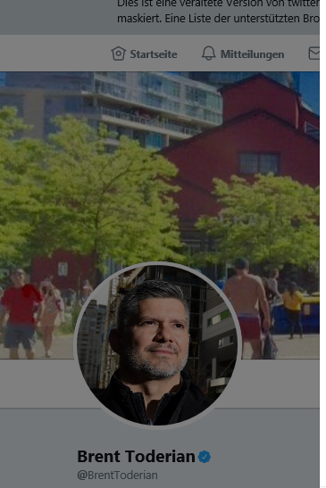
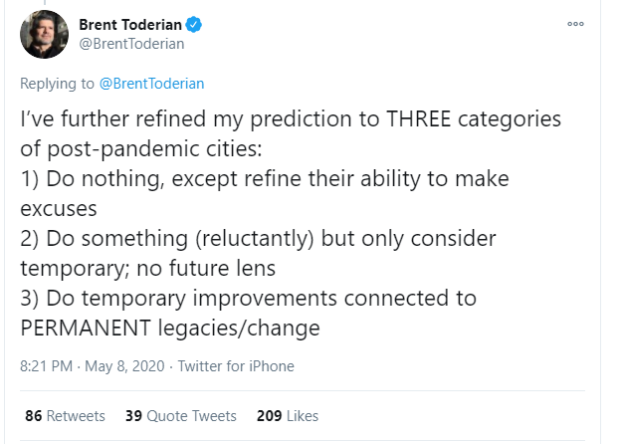

Recently on Twitter…
https://twitter.com/BrentToderian/status/1258824268034437120

Slide 3
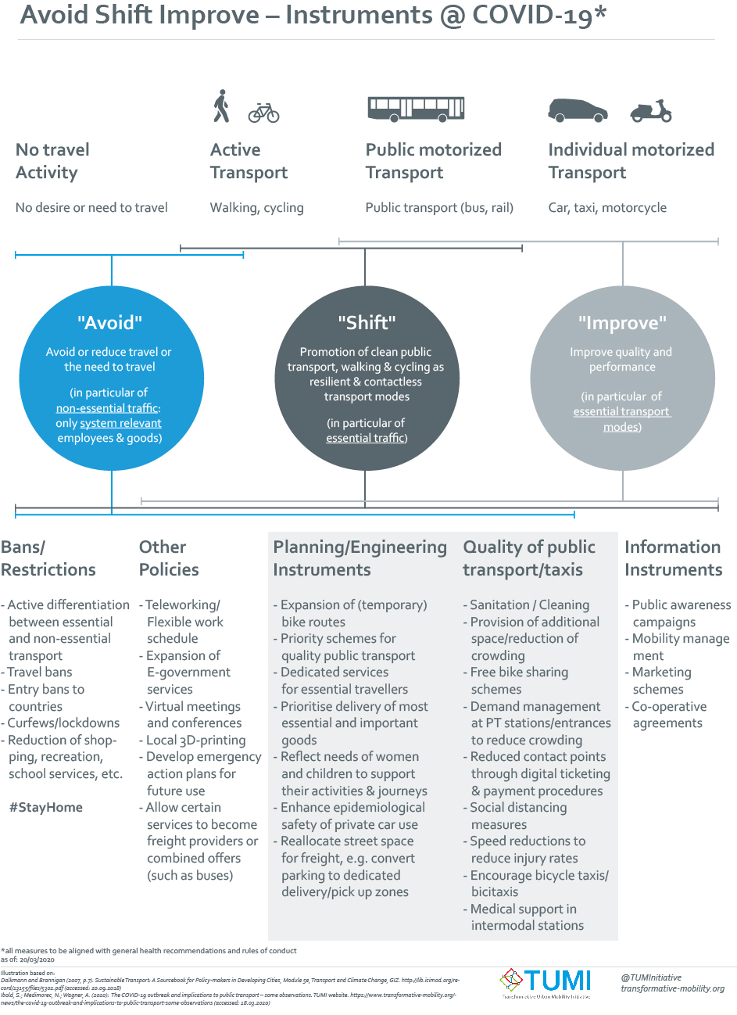

Slide 4
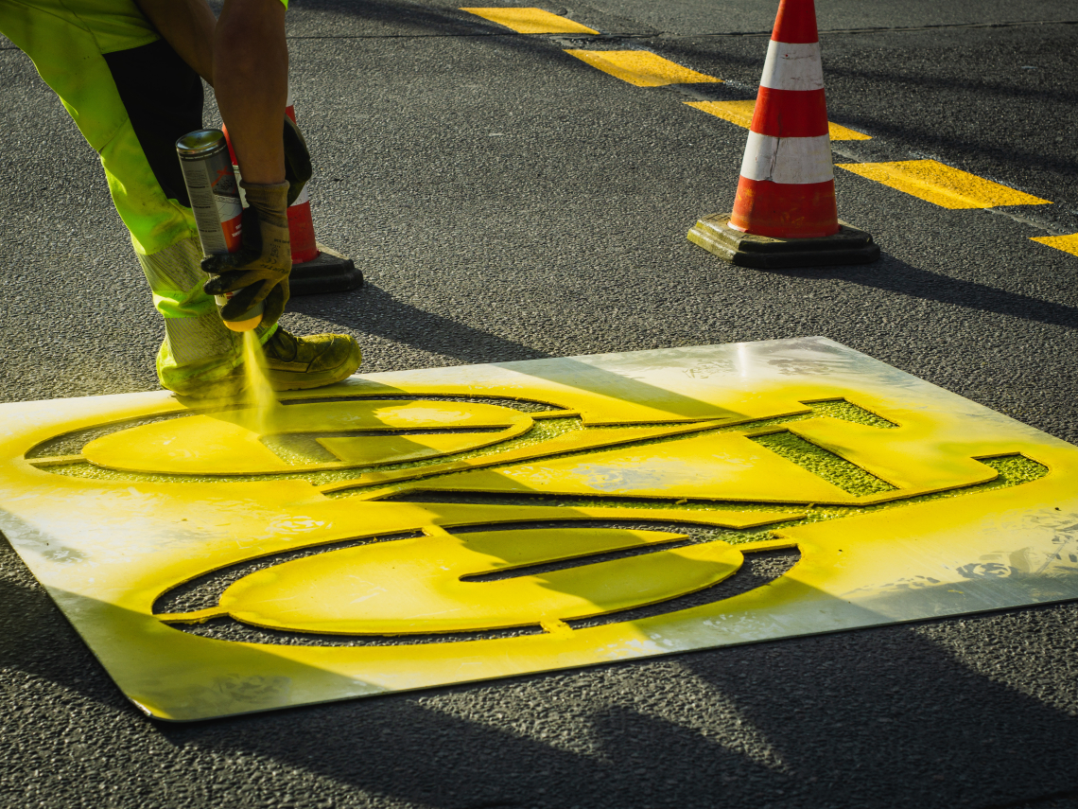
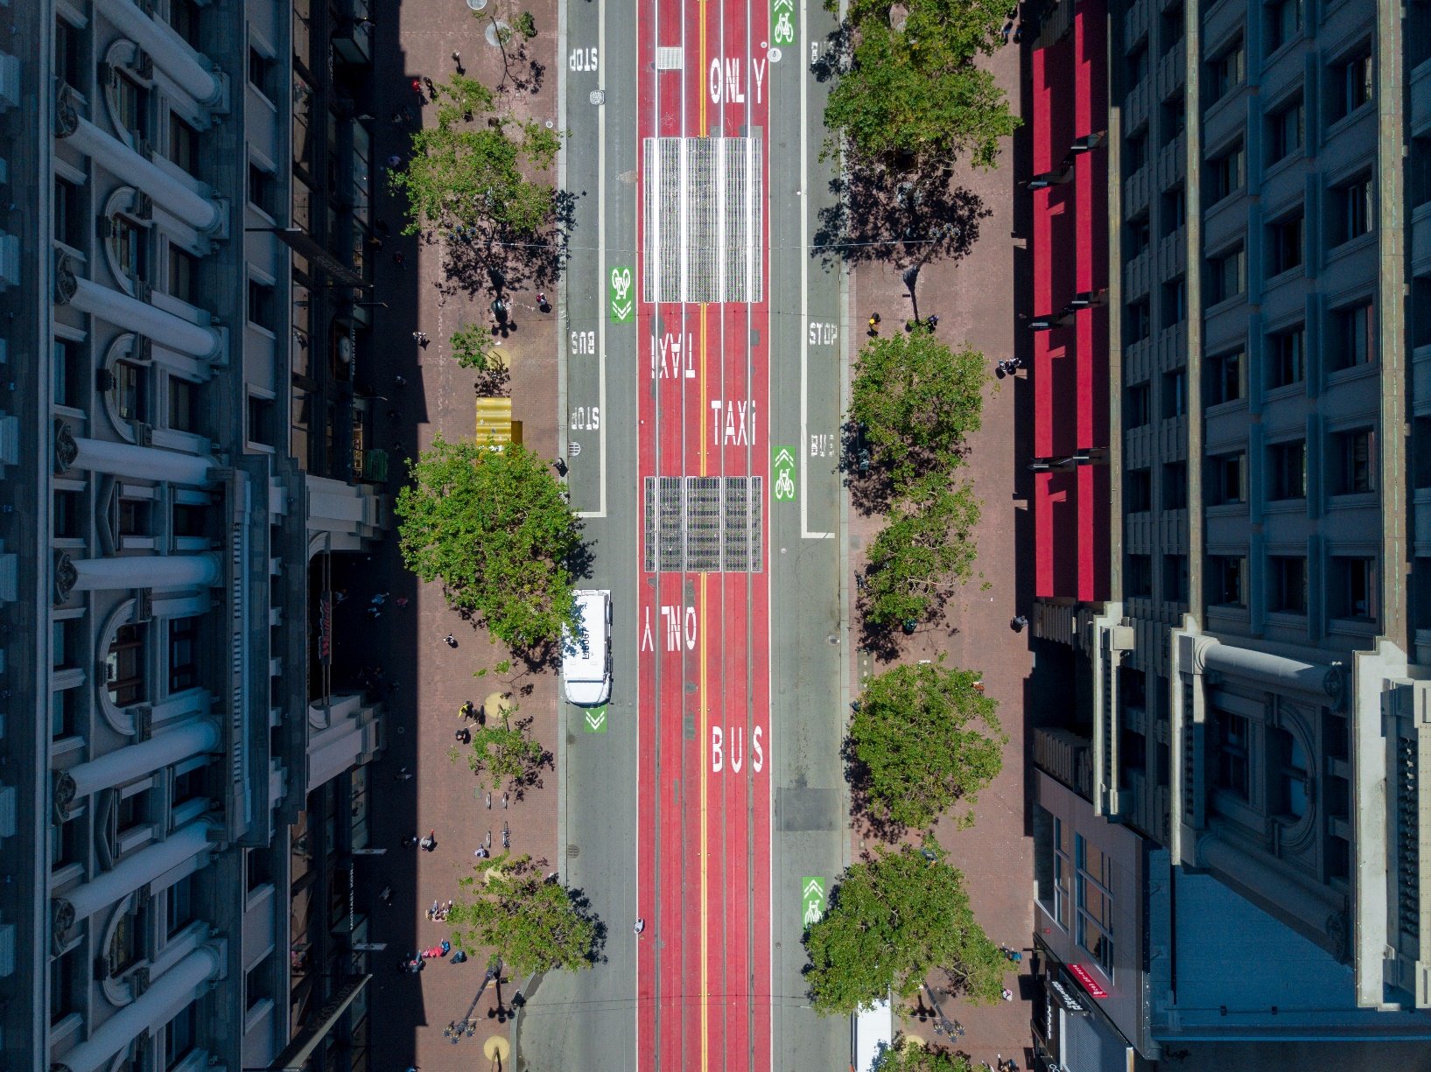
Key trends:
Pop-up infrastructure
Bus priority schemes
Open streets
Contactless ticketing
New work policies
Digitalization
…

Slide 5
Reduction of (motorised) transport demand (Avoid)
Promotion of compact resource and space-saving, human-centred accessible, barrier-free, mixed-use oriented cities
Promotion of remote working and learning
Mobility bonuses for sustainable mobility solutions such as public transport, (e-)bicycles, cargo bikes, company bicycles, e-bike charging stations among others
Linking the promotion and implementation of transport measures to increasing energy efficiency and mitigating CO2 emission
Avoid
Avoid
Promotion of public transport and active mobility (Shift)
Improving the quality of transport (Improve)
Promotion of safe, reliable, affordable, accessible and high-quality public transport, cycling and walking
Restore confidence in public transport
Shift
Improve

Slide 6



New Work. New Communication.
Real real-time data generation and use
Immediate, knowledge-based emergency response
Instantification of knowledge generation
Massive acceleration of knowledge sharing
Crowd-sourced, agile concept development, implementation and sharing.
Vertical process → horizontal processes

Slide 7
More on www.transformative-mobility.org
Armin.Wagner@giz.de
https://twitter.com/tuminitiative
https://twitter.com/urbanarmin

