Slide 1

A Digital Financial Education to Support the "New Normal“ in the Post-Pandemic Era
VALERIA STEFANELLI, MARCO TRINCHERA, VITTORIO BOSCIA
valeria.stefanelli@unisalento.it, marco.trinchera@unisalento.it, vittorio.boscia@unisalento.it
UNIVERSITY OF SALENTO, ITALY

Slide 2

Introdution
The Covid-19 pandemic has accelerated the digital transformation strategy of firms to support business continuity online, in response to government restrictions
The effectiveness of these business strategies depends on the familiarity and awareness of consumers with the use of online channels and therefore with the use of digital payments necessary to conclude transactions in marketplaces
The contribution outlines a series of recommendations aimed at elevating and strengthening the degree of Digital Financial Education of individuals

Slide 3
Background (1/2)
In Europe, strong disparity between North and South and greater digitization of processes in Northern European countries (DESI, 2020)
Knowledge gap on financial education for young people but even more so for adults
High gender differences in financial knowledge (OCSE, 2016)

Slide 4
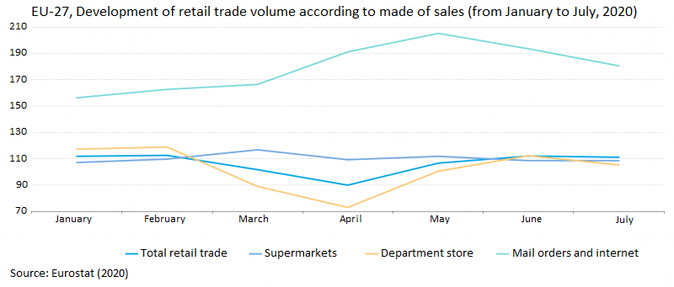
Background (2/2)
The pandemic has generated an acceleration of the digital transformation in various economic sectors and in consumer purchasing habits
The e-commerce sector has been instrumental in coping with coronavirus restrictions
Cash for ↓ amounts
Card for ↑ amounts

Slide 5
Policy and managerial implications
Financial education of young people
  Financial Education Days in Secondary School Programs
  Advertising campaigns through social networks (Instagram, Tik Tok, Facebook, etc.)
Financial education of adults
  Awareness campaigns, exploiting the television spaces (advertising, ad hoc television programs, etc.)
Reduction of gender inequalities
  Advertising campaigns relating to specific products intended for female audience
  Tax relief to uniformly spread the use of digital technology in the economy
On the side of businesses, banks, and financial intermediaries
  Promotional campaigns that reduce, in terms of costs, the differences between accepting cash and accepting digital payments

