Slide 1

Financial reforms for resilience in the Mediterranean
Luis Reyes and Thomas Lagoarde-Segot
luis.reyes@kedgebs.com ; thomas.lagoardesegot@kedgebs.com
Kedge business School

Slide 2

Introduction
Inclusive growth and poverty reduction are important for fostering justice and reducing inequalities
The COVID crisis has hit a region under severe economic and social and political stress
Mediterranean countries are simultaneously suffering the consequences of the pandemic and the pre-existing international financial instability
Oil producers/exporters have been directly affected by the decline in demand and the price of oil
These economies are vulnerable to the slowdown in FDI, especially coming from Europe

Slide 3
Vulnerability of Southern Mediterranean countries
Global financial transmission mechanisms of the lockdown include:
  Adverse commodity price developments (especially for oil-producing and exporting countries)
  ↑ in global risk aversion
  Rush to the USD
  ↓ the value of the domestic currency against the USD
  ↓ in capital inflows (particularly FDI)
These developments make foreign debt more difficult to honor
Since the USD is the dominant currency, capital has been flowing from South to North, instead of the other way around

Slide 4
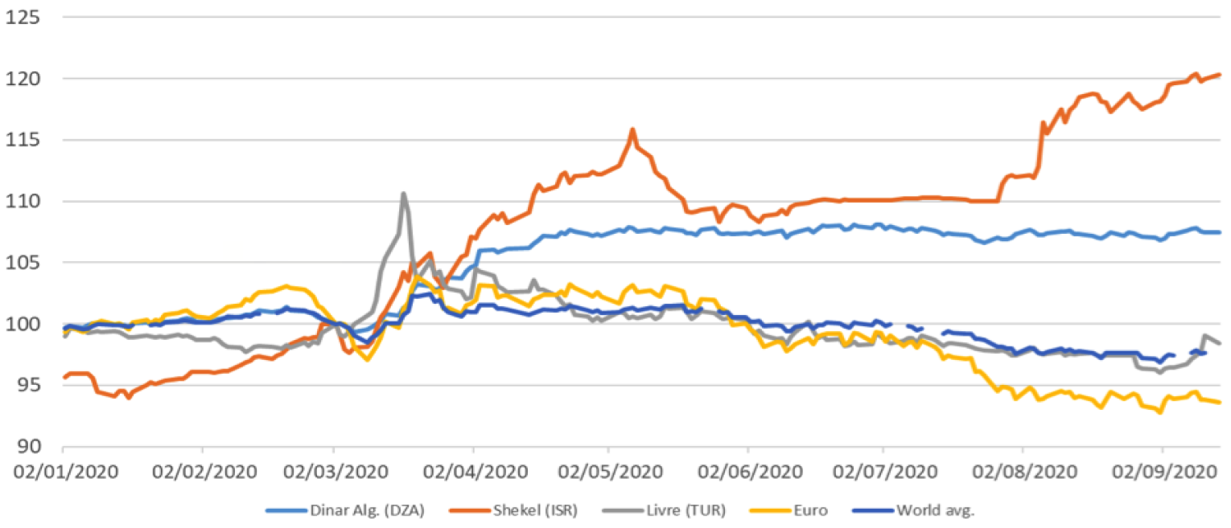
Nominal exchange rate vis-à-vis the USD, 2/3/2020 = 100

Slide 5
Conclusion and some policy recommendations
ECB swap lines to cover liquidity needs
Given the possibility of a USD devaluation starting next year, financing investments could be
  Also denominated in other currencies (euro, yen, yuan, sterling)
  Rapidly provided via Special Drawing Rights, managed by the IMF
Regional cooperation measures for the regulation of capital flows (in particular to prevent further devaluations)
Creation of an extra-financial Euro-Mediterranean rating agency, which takes into account ESG criteria

