Slide 1
Séquence 6 : Instruments économiques des politiques de l’environnement
"South-Med strategies and instruments for climate change : what consistency of action for mitigation/adaptation and what further needs ?”
Constantin TSAKAS
Institut de la Méditerranée and FEMISE

Slide 2
Who are we ?
About Institut de la Méditérranée : Institut de la Méditérranée (IM, Marseille, France) was founded in 1994 by the PACA Region, the General Council of Bouches-du-Rhône, the City of Marseille and the Marseille Provence Chamber of Commerce and Industry and develops socio-economic expertise and projects related to the wider Euro-Mediterranean region. It is one of the founders and coordinators of the FEMISE network, the first research network in the Euro-Med region.
About FEMISE : FEMISE is a network of research institutes from the North and South of the Mediterranean, which promotes dialogue and research on socio-economic issues and advises Mediterranean Partner Countries on reform. It is coordinated by the Economic Research Forum (Egypt) and Institut de la Méditerranée (France).
The content of this presentation borrows elements from the ENERGIES2050, Institut de la Méditerranée, FEMISE joint publication on « The Challenges of Climate Change in a Mediterranean in Transition – from the Paris Agreement to Implementation » (forthcoming 2018)

Slide 3
Introduction
"South-Med strategies and instruments for climate change : what consistency of action for mitigation/adaptation and what further needs ?”
The economy and the environment are closely inter-linked. Production and consumption processes make us doubly environmentally-conscious : on the one hand, by taking natural resources to produce goods and services, on the other hand by emitting waste into the environment as a result of the processes.
Therefore today, sustainable development is entering into a growing number of sectors creating opportunities for economic growth.
However, we must face the reality of climate variability (see next figure). Southern Mediterranean countries (SMCs) are vulnerable to the impact of climate change. This is due to their geographical position and dependence on climate-sensitive sectors. Rising sea and ocean levels are likely to endanger the lives of millions of people living in coastal areas. At the same time, the problem of inadequate freshwater is a real danger which could result in drought in several regions. There are also effects to anticipate, the assessment of the economic cost of climate change and planning for rapid adaptation to climate change is more than necessary.

Slide 4
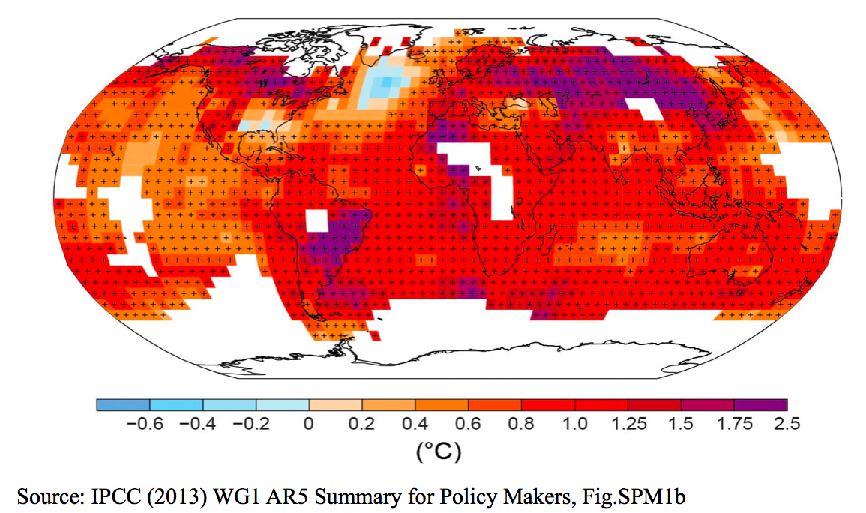
Introduction
Reality of climate variability : Observed change in surface temperature 1901-2012

Slide 5
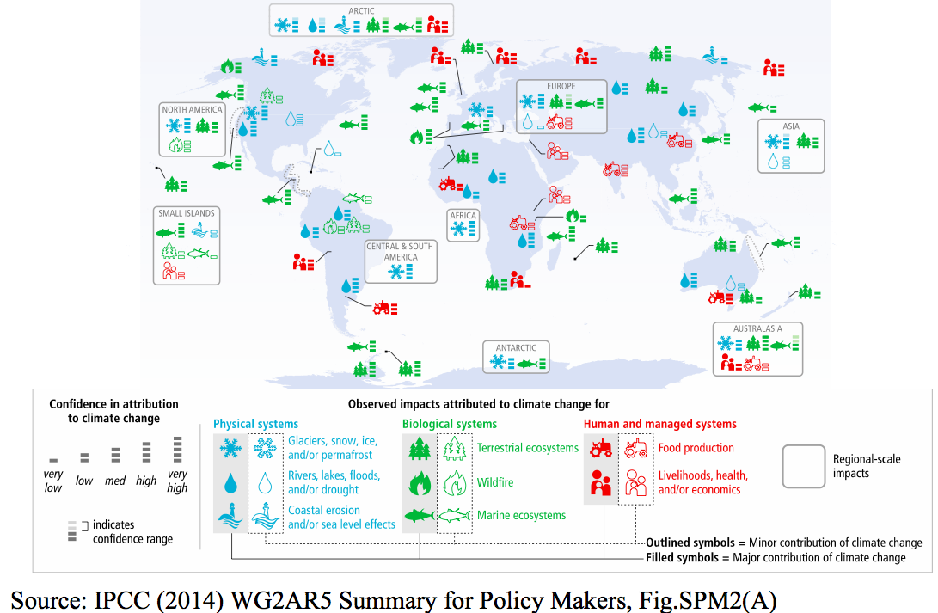
Introduction
Global patterns of impacts in recent decades attributed to climate change
In SMCs, increase in temperature could lead to (FEMISE est*) :
a decrease in tourist demand in coastal areas by 6%,
severe impact on agriculture (15% of the GDP),
a 1 ° C would cause a GDP per capita decline of 8% on average,
A risk of population displacements due to sea level rise (Turkey, Egypt, Tunisia)

Slide 6
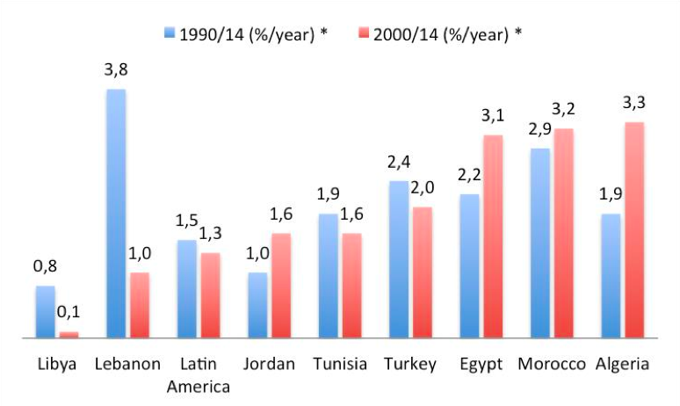
Introduction
Annual growth of CO2 emissions per capita
per capita CO2 emissions have increased significantly in many SMCs
likewise, SMCs performance in terms of RE deployment remains behind other regions…
Source : Institut de la Méditerranée calculations based on ENERDATA
All in all, opportunities are to be seized and externalities need to be compensated.
The question is HOW ?
With WHICH ECONOMIC INSTRUMENTS ?

Slide 7
Which economic instruments to tackle climate change?
A plethora of instruments, IM & FEMISE have identified the following typology:
Providing Env. Goods (ex. Green public procurement)
Environmental Regulations (Standards, Bans, Quotas etc) (ex. emissions standards for vehicles, mandatory limitations of coal resources extraction)
Creating Markets (Property Rights, Tradable permits etc) (ex. EU Emissions Trading System, within a cap, firms receive/buy emission allowances to trade)
Using Markets (Subsidy Reduction, Environmental Taxes, Deposit-Refund Systems, Targeted Subsidies) (ex. carbon taxes in place in many countries, subsidies to renewable energy, reducing subsidies to fossil fuels)
Others (Public Participation, Information Disclosure) (ex. energy standards, energy labeling of buildings, mand. requirements for institutional investors)
What about the SMCs in all this ? They adopt some of these tools in specific sectors.
Most notably Renewable Energies, Transport and Waste Management in which we will focus our analysis.

Slide 8
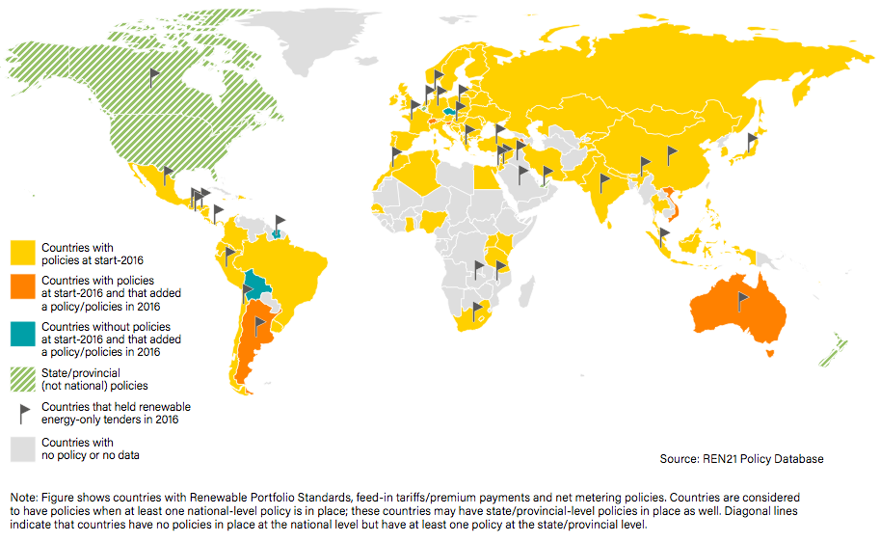
SMCs : State of play (REs)
Countries with Renewable Energy Power Policies, by Type, 2016
All SMCs (exc. Libya) have policies at start 2016)
Morocco, Turkey, Jordan held RE-only tenders in 2016

Slide 9
SMCs : State of play (REs)
Public procurement initiatives in RE (T1)
Morocco called for tenders totalling 1 GW of large-scale renewable energy projects.
In Palestine, the Palestinian Energy Authority launched its first tenders in 2016, aiming to boost installed solar PV capacity by as much as 100 MW.
Israel ended its two- year hiatus on new solar power deployment by launching plans to issue more than 1 GW of new solar tenders, as well as tenders for a 500 MW solar PV project in the Negev desert and a 40 MW PV project in Ashalim
Jordan announced its third round of tendering for solar power and its second round for wind power, including a new 200 MW solar PV tender.
Environmental Regulations : Targets Set for RE Heating and Cooling (T2)
Jordan : Solar water heating systems for 30% of households by 2020
Lebanon : 15% renewables in gross final consumption in power and heating by 2030
Libya : Solar water heating: 80 MWth by 2015; 250 MWth by 2020
Morocco : Solar water heating: 1 .2 GWth (1 .7 million m2) by 2020

Slide 10
SMCs : State of play (REs)
Creating Markets : Photovoltaic Guaranteed Price in Algeria (T3)
The guaranteed purchase tariffs for electricity produced from facilities using the photovoltaic solar sector as well as the conditions for their application have been set by a ministerial decree published in the official journal of 23 April 2014.
The purchase contract is concluded for 20 years from the date of commissioning of the connection. During this period, the producer receives, in a first phase, which corresponds to the first five years of this period, the single purchase price fixed and calculated on the basis of an estimated reference potential of 1500 hours of full load operation. In a second phase, and for the remaining duration of the contract, the single tariff can be readjusted, depending on the real potential of the site.
Using Markets : Financing Energy Transition in Algeria (T4)
national energy consumption tax (0.0023 DA / Thermie for high and medium pressure
natural gas, 0.030 DA / KWh for high and medium voltage electricity)
taxes on energy-consuming appliances: apparatus operating on electricity, gas and
petroleum products whose consumption exceeds the specific energy consumption
standards set by the regulations. This tax is progressive: 5% on products of category A, then 30, 35, 40, 45 and 50% respectively for products of category B, C, D, E and F.

Slide 11
SMCs : State of play (Waste Management)
Using Markets : Tunisia’s subsidy scheme in pollution fight (T4)
The Tunisian Fund of Depollution (FODEP) grants a subsidy for companies that work in the fight against pollution. Eligible projects include : i. Individual or collective depollution installations for the benefit of several companies grouped together and carried out by public or private operators and ii. Projects for waste collection and recycling units.
FODEP grants a subsidy capped at 20% of the cost of the approved investment. Eligible projects also benefit from a bank loan with a term of 3 to 7 years with a 3-year grace period. There is exemption from all duties and taxes on equipment.
Using Markets : Tax Protection for the environment in Tunisia (T4)
5% of turnover excluding tax on the VAT made by concerned manufacturers : plastic articles (such as boxes, crates, bags, bottles , cutlery, household items ...); resins; insecticides; fuels; chemical products ; batteries etc...

Slide 12
SMCs : State of play (Waste Management)
Using Markets : Morocco’s fees for prevention of envir. discharges (T4)
The spill, discharge or deposit on water requires an authorization and payment of a Spill Fee. This fee is a causal tax with an incentive effect based on the "polluter payer" principle. Release limit values ​​have been set, in the surface treatment industry they are: 4 mg / l of copper, 1 mg / l of lead, 10 mg / l of zinc); in the cement industry releases of heavy metals are limited to 15 mg / l, Domestic wastewater discharges are limited to 120 mg for suspended solids, 250 mg for releases from chemical oxygen demand, and 250 mg for biochemical oxygen demand.
Two other fees are provided for under a Waste Management and Disposal Act:
- A fee is levied (rate set at the municipal level) for services rendered by the public service of household waste.
Municipal services responsible for the management of household waste receive a fee if they receive and manage inert waste, agricultural waste, non-hazardous ind. waste.
An eco-tax on plastic (extended to packaging) has been put in place. This 1.5% ecotax applies to the sale, import of plastics, the proceeds of which must be allocated to the National Environment Fund in order to develop the plastic recycling sector.

Slide 13
SMCs : State of play (Tourism and Transport)
Using Markets : Tunisia’s tax on the re-registration of used cars (T4)
50 DNT for cars sold 4 years after the date of first entry into service, 100 DNT for cars sold after 10 years; increase of 50 TSD for cars with a power between 6 and 9 tax horses and 100 DNT for cars with a power of more than 9 tax horses. This tax is collected by the Technical Agency for Land Transport.
Using Markets : Morocco’s subsidy Moussanada Siyada for eco-labelling (T4)
• It is a mechanism for SMEs in the sector (tourist accommodation, travel agencies, passenger transport) that serves as support (in terms of subsidies and technical support) for companies in their certification / labeling in sustainable development, the performance of energy audits or the establishment of an environmental management system. The financial contribution of the scheme is capped at 1 MDH per company, in the form of subsidies ranging from 60% to 80% of the cost of the selected services.
Other: RENOVOTEL 3 Fund (T5)
• It is dedicated to the upgrading of tourist establishments through the financing of investments, taking into account environmental issues. It is a joint financing fund with banks, dedicated to upgrading classified EHTs. With an envelope of 500 MDH, capitalizes on previous editions through reduction of administrative procedures, reduction of the contribution in own funds, extension of eligibility to host-houses.

Slide 14
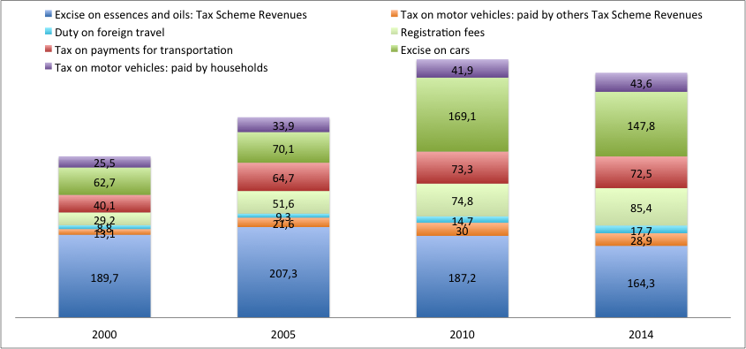
SMCs : State of play (Tunisia Revenues)
Revenue raised (in millions USD) by Tax Schemes (Source: OECD.stat, FODEP, IM calculations)
1,35% of GDP
1,16% of GDP
1,43% of GDP
1,72% of GDP

Slide 15
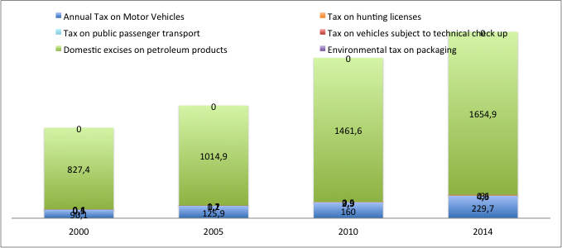
SMCs : State of play (Morocco Revenues)
Revenue raised (in millions USD) by Tax Schemes (Source: IM calculations based on WDI Online, OECD.stat)
1,72% of GDP
1,35% of GDP
1,16% of GDP
1,43% of GDP
1,75% of GDP
1,72% of GDP
1,83% of GDP
2,36% of GDP

Slide 16
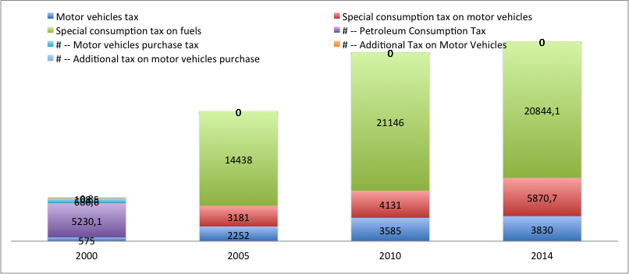
SMCs : State of play (Turkey’s Revenues)
Revenue raised (in millions USD) by Tax Schemes (Source: OECD.stat, IM calculations)
3,83% of GDP
3,94% of GDP
4,12% of GDP
2,77% of GDP
Decree No. 2016/9153, increased special consumption tax (SCT) rates on petroleum.
On petrol : Between TRL2.37-TRL2.49 per liter (previously TRL2.15-TRL2.39 per liter)
On diesel : Between TRL1.72 -TRL1.79 per liter (previously,TRL1.51-TRL1.59 per liter)
Source: http://taxinsights.ey.com/

Slide 17
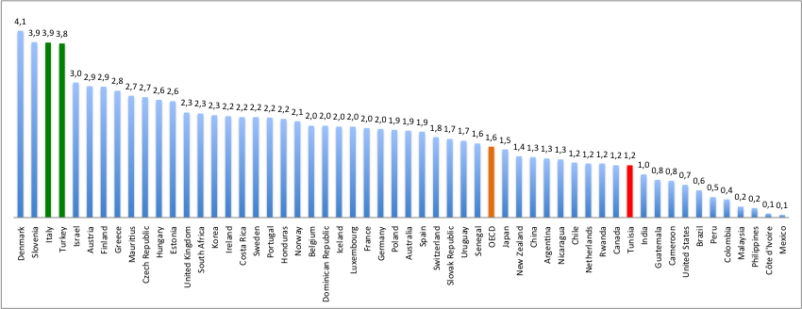
SMCs : State of play (Revenues OECD)
Environmental Taxes, Total revenue, % of GDP 2014 (Source: OECD.stat)
Slovenia and Tunisia have practically the same GDP (42.1bn US$ VS 44bn US$)
What is Slovenia doing « better » to earn so much Environmental Revenue?

Slide 18
The Case of Slovenia : a case to be studied
Established a comprehensive environmental legislative framework in the last decade, introducing risk-based inspections and improving compliance monitoring. Emissions-reduction, disaster-assessment, drinking-water and waste-management plans are under development.
Took economic tools taken to the « next level » (CO2 tax , Additional tax on motor vehicles, Contribution of Nuclear power plant to finance de-composition, Electric power and coal, End-of-life vehicles tax, EE tax, Fuel excise tax, Indemnity for the restricted use of area on the territory of Nuclear power plant, Landfill tax, Motor Vehicle Tax, Registration fees on motor vehicles, boats and airplanes paid by individuals AND by legal entities, Tax on lubricating oils, Tax on packaging waste, Tax on waste electrical and electronic equipment, Tax on waste pneumatic tyres, Taxes on air pollution, Taxes on waste pollution, Volatile Organic Compounds tax, Wastewater pollution tax, Payment for water rights, Water abstraction charge, Water consumption charge)
Financial support given to individuals for energy efficiency and RE use.
Slovenia works closely with immediate neighbors on water management and biodiversity issues, and maintains informal professional contacts with countries of the western Balkans. Environmental NGOs play domestic watchdog role.

Slide 19
Strategic and Institutional Context
In Algeria, a first decree dates back to April 15th 2006 and regulates and controls the emission of gases, smoke, stream, liquid or solid particles in the atmosphere. The second decree (13/110) of March 17th 2013 regulates the use of ozone depleting substances.
In Morocco, environmental laws were approved in 2003 on the protection and conservation of the environment, combating air pollution and on environmental impact assessment. On 2008, it implemented the “Plan Vert pour le Maroc” with heavy focus on sustainability of the agricultural sector. A year later it adopted its “Plan Bleu pour le Maroc” applied on the fisheries sector. After adopting constitutional reforms (especially during Arab Spring) stipulating that sustainable development is a right of every citizen, the Morocco drew a “Climate Change Policy of Morocco” on March 2014.
Tunisia is one of the few countries to recognize climate change in its Constitution (on January 2014). Recently, the government established a National Strategy on Climate Change (NSCC), which takes into account the new challenges and directions of the post-revolutionary Tunisia. Tunisia adopted the “Renewable Energy Action Plan 2030” by the Ministry of Energy, Mines and Renewable Energy on November 22, 2016. Its aim is to strengthen both the national fossil and renewable energy resources by improving energy intensity by 3% per year during 2016-2030 and save energy by 17% between 2016-2020.

Slide 20
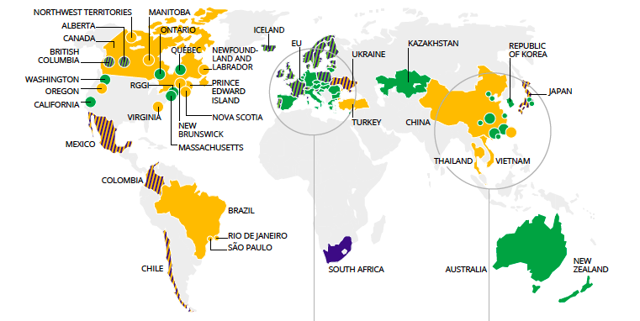
Strategic and Institutional Context
No Carbon Market in the SMCs : Summary map of carbon pricing initiatives
implemented, scheduled for implementation and under consideration
Source: World Bank State and Trends of Carbon Pricing 2017

Slide 21
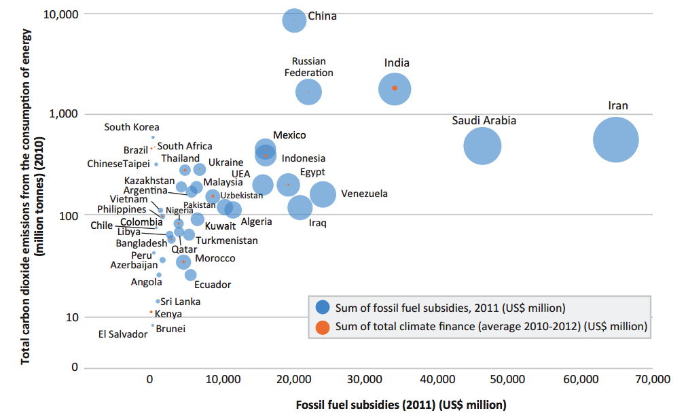
Strategic and Institutional Context
Transitioning from Fossil fuels to Climate Finance will take time
Fossil fuel subsidies, climate finance and greenhouse gas emissions in developing countries
Source: http://newclimateeconomy.report/2015/wp-content/uploads/sites/3/2015/11/Fossil-fuel-subsidy-reform_from-rhetoric-to-reality.pdf

Slide 22
Current and future challenges and opportunities
Key issues: Socio-economic context post-Arab Spring and Financing (or lack thereof)
Insufficient public resources in a post-crisis context
Environmental taxation is very little / not developed in SMCs.
High unemployment, many employed in labour and energy intensive industries. What happens to them if SMC’s go green ?
Long-Term Issue: reorient savings and human capital towards low-carbon projects

Slide 23
Recommandations
Continue adaptation, coherence and operation of the legislative framework adddressing green economy challenges
The economic and social reality of MED countries cannot be neglected as reducing carbon emissions may affect workers in energy-intensive industries. Compensatory schemes need to be thought of and put in place. Go green, but do it intelligently.
Solutions must now be examined taking into account the dynamics of social and financial innovation (Ethical Banks, equity instruments, Social Impact Investment Envelopes), in order to bring them together in a large partnership towards a resilient low-carbon Mediterranean that has principles of solidarity and economic convergence.
Develop environmental taxation
SMCs need to cooperate, exchange good practices. Active advocacy towards policy makers is needed
To this day, there is no inventory as to the impact assesment of economic instruments for climate change applied in the SMCs. This needs to change.
Create a MED Climate-Data observatory

Slide 24
Some other useful sources of data and information
Morocco 4C is a public interest group created with the support of the German cooperation for sustainable development. 4C aims at the development of climate change mitigation instruments by strengthening the skills of key players in Moroccan society (administration, private sector, civil society and research). The portal does not provide datasets, but information on developed indicators (Temperatures, Biodiversity, Emissions, Green tourism etc) and reports on regional climate change.
Enerdata is an economic research bureau specializing in the energy sector and its interactions with the environment.
European Network for Earthsystem modelling (ENES) : It develops the Climate4mpact database. The database contains modeling of the effects of climate change. It provides a quick view of regional climate models and provides data visualization tools.
OECD Environmental Taxation Database (Turkey, Israel, Tunisia only)

Slide 25
*FEMISE/IM related sources of data and information
ENERGIES2050-FEMISE-IM report (2018 forthcoming), “The Challenges of Climate Change in a Mediterranean in Transition – from the Paris Agreement to Implementation”, March-April (forthcoming)
Rafael de Arce and Alejandro Lorca (2013), « L’impact d’un cluster sur les énergies renouvelables dans les pays du Sud: viabilité et impact économique au Maroc », étude FEM35-05, mai 2013
Péridy et al, 2012, « Le coût économique du changement climatique dans les pays MENA : une évaluation quantitative micro-spatiale et une revue des politiques d’adaptation », étude FEMISE FEM34-03, Juin.
Abeer Elshennawy (2009), « Changement Climatique et croissance économique : analyse par un modèle d’équilibre général intertemporel pour l’Egypte », étude FEM34-23, octobre.
and others at www.femise.org

Slide 26
THANK YOU !

