Slide 1
Impact of Refugees on Neighbors The Good, the not so Good …And the Bad
Raed Safadi, ERF and Femise
Femise Annual Conference
Casablanca, April 2017

Slide 2
We know that refugees….
Are forcibly displaced people who have also acquired vulnerabilities (e.g., catastrophic losses of assets or trauma) reducing their abilities to seize on economic opportunities & may trap them in poverty
May provide convenient scapegoats for deep-rooted issues, but they are often not the main cause of all the difficulties facing host countries
Crises don’t occur in a vacuum: they are heavily impacted by the underlying social and political fabric of a country
Require both humanitarian & developmental responses

Slide 3
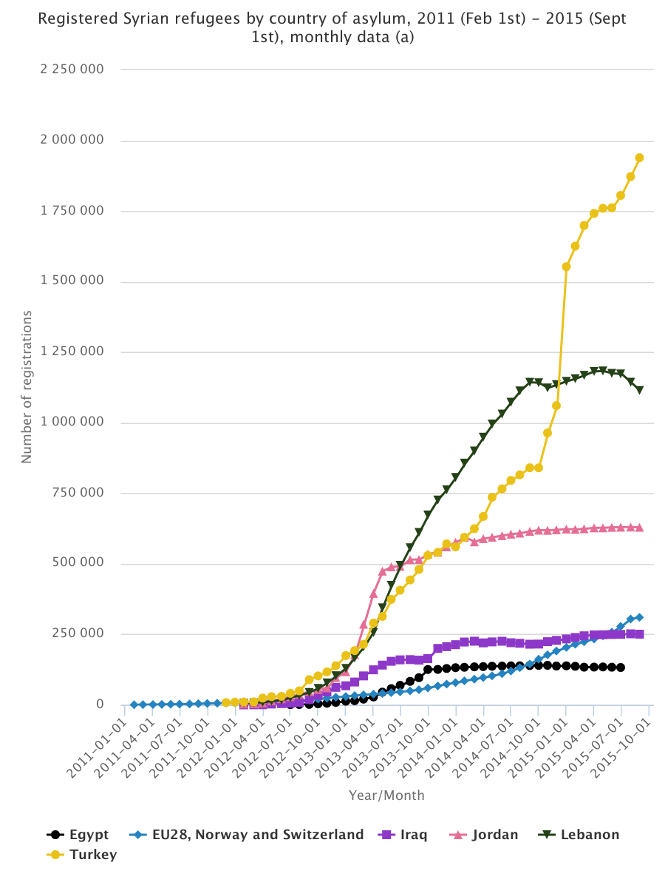
The Syrian Refugees, where are they?
World is confronting its worst refugee crisis since WWII. As of December 2015, UNHCR had registered over 4.39 million Syrian refugees with most residing in……

Slide 4
Syrian Refugees, where to? A Digression
Combined population of Jordan, Turkey, and Lebanon is 94 million and a nominal GDP of roughly $900 billion.
EU has a population of 500 million and a GDP of $18.4 trillion.
USA has a population of a of 319 million and a GDP of $17.4 trillion.

Slide 5
For Better or Worse
Refugees can be a boon to the host country if they:
Spur long-term investment & bilateral trade with country of origin
Fill needed demographic gaps
Integrate effectively into the labor market
Become productive economic consumers and producers
Refugees can also be a burden on the host country if they:
Strain public and private services
Cause physical and economic overcrowding and
Increase societal strife and the potential for civil conflict.

Slide 6
Influx of Refugees, A Shock
Welfare
Policy Response
Better Outcomes
Initial Conditions
Shock

Slide 7
Initial Conditions to Keep in Mind, The Economy

Slide 8
Initial Conditions to Keep in Mind, The People

Slide 9
Initial Conditions to Keep in Mind, The Outcomes

Slide 10
Actual Impact, what studies show
Studies find that the Syrian conflict in general has caused greater macro-economic challenges in host countries than the Syrian refugees:
Host countries have lost major trade routes through Syria and have had to adopt more expensive alternative routes, increasing export prices and hurting competitiveness
Jordan’s agricultural exports to Syria decreased by around 43% over 2013 compared to the same period the year before
Jordan’s tourism sector has also been badly impacted with income in the first nine months of 2011 falling by 18%
Regional insecurity and uncertainty have impacted investor and consumer confidence in Lebanon, with economic growth declining from 8% between 2007 and 2010 to 3% in 2011 and 2 per cent in 2012.
In Turkey, the biggest impact has been the dramatic decline of trade with Syria. Tourism in Turkey has also been affected, with tourists coming from Britain and Russia estimated by one Turkish newspaper to have declined by 30 per cent

Slide 11
Actual Impact, what studies show
Syrian refugees have contributed to host country economies through increased investment by both Syrian diaspora and Syrian businesses.
In Turkey, 26 per cent of newly registered businesses in 2014 had Syrian ownership or capital (World Bank).
In Jordan, Syrian direct investment has accelerated industrial activity, creating employment opportunities for both Syrians and Jordanians.
Humanitarian aid is helping host countries directly, and through economic programs that support vulnerable host populations to find work:
In Lebanon, UNHCR and UNDP have found that for every USD 1 spent on humanitarian assistance, economies experienced a multiplier value of USD 1.6
The UN estimates to have spent USD 800 million annually on Syrian refugees in Lebanon, with 44% of this amount injected directly into the economy
Each USD 1 that beneficiaries spent generated USD 2.13 of GDP for the Lebanese economy

Slide 12
Actual Impact, what studies show
Syrian refugees predominately work in the large informal markets of host communities
These markets have been served by migrant workers, including Syrian workers, long before the influx of Syrian refugees.
Historical trends and host government policies and practices restricting Syrian refugees’ access to the formal sector, competition for jobs has been predominately with other migrant workers in informal sectors, mainly construction and agriculture.
The recent influx of refugees has led to a decline in wages as refugees are willing to take lower pay due to their constrained circumstances.

Slide 13
Policy response
Absorbing the shock requires both Technical & Political responses
Humanitarian & developmental responses need not be sequential. Work for a comprehensive response that exploits synergies and complementarity between the two sets
Address long-standing developmental issues, especially those that refugees may exacerbate
Strengthen and expand service delivery, especially in the education and health sectors
Avoid putting refugees in limbo by supporting policies that grant them freedom of movement AND right to work taking into account the needs of local populations, and existing (poor) labor market outcomes
Think long-term: “Temporary” structures such as schools, medical clinics, housing developments, and roads to access refugee camps need not be temporary
When permanent, these structures can bolster the host country’s infrastructure and development prospects, and may erase the short-term negative economic shocks of refugees influx

