Slide 1
Sustainability of EU-Med Macroeconomic Policies and the Role of the Private Sector: Post-Financial and Debt Crises
Simon Neaime
Professor of Economics and Finance
Director, Institute of Financial Economics
American University of Beirut
IFE-FEMISE Conference: Unlocking the Potential of the Private Sector in South Med Countries, AUB, BEIRUT, 5th December 2016

Slide 2
Outline
1. Introduction
2. EU and MED Macro economy
3. EU and MED Financial Markets
4. The Role of the Private Sector
5. Exchange Rate Channel: Depreciation of the Euro
6. Macroeconomic Dynamics of EU and MED Public Debts
7. Conclusion

Slide 3
1. Introduction
2008 international financial crisis and the economic and political uncertainty that has characterized the MED region since the uprisings of 2011 continue to dampen the prospects for growth, job creation, fiscal balances and macroeconomic stability
Limited fiscal space and fixed exchange rates in the presence of open capital accounts have rendered government macroeconomic policies ineffective in MED countries
Central banks have adopted policies that were not in consonance with the received wisdom. QE implemented in the West and Japan did not yet succeed in achieving macroeconomic stability
So far the massive injection of money in the US and EU has had no impact on growth and inflation
Where is the money going? The central problem in monetary policy making has been in finding out how much of the extra money results in an increase in output and how much in inflation

Slide 4
A major policy issue to be faced in the coming years is whether monetary policy has reached a dead end and is in a bind
If traditional macroeconomic policies have not helped, are there any new directions that will not only solve the current financial/debt crises but also prevent future ones from developing?
Are we back to the old controversy on fiscal policy versus monetary policy in tackling macroeconomic imbalances ?
What about the introduction of macroeconomic stabilization programs in EU and MED countries, is there still room to use both monetary and fiscal policies in tandem to curb those macroeconomic imbalances?

Slide 5
With the current debt crisis in several EU countries, low GDP growth rates and oil prices and high debt levels in several MED countries, fiscal policy is for sure not a policy option anymore due to limited fiscal space
Also with fixed exchange rates, monetary policy is not a policy option in many MED countries
With one monetary policy conducted by the ECB and the absence of a political union, EU countries have registered over the past decade significant current account and budget deficits
QE implemented by the ECB since 2015 is perhaps the only macroeconomic policy tool still available to avert an overall financial and debt crisis in the EU

Slide 6
Introduction (cont.)
However, is QE the appropriate stabilization policy the ECB should follow to stimulate growth, fight deflation, and help EU countries with unsustainable public debt?
Has the ECB waited too long before implementing its QE policy?
Will that be a raison behind QE not achieving its stated objectives and endangering therefore the future of the EU?

Slide 7
2. EU and MED Macro economy
Recession and deflation coupled with large fiscal imbalances in the EU and MED (large budget and current account deficits and accumulated public debts)
Average unemployment rates increased to over 15 percent
Increases in real interest rates-> discouraged spending and investment and have lowered real GDP growth rates
Introduced austerity measures are further lowering wages and prices, aggregate demand, and the rate of growth of GDP

Slide 8
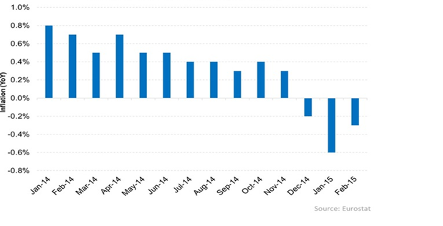
Figure 1.EU’s Inflation Rates: 2014-2015

Slide 9
Figure 2. MED Macroeconomic Indicators: 2010-2019
Real GDP Growth (%)
Year Country | 2010 | 2011 | 2012 | 2013 | 2014 | 2015 | 2016 | 2017 | 2018 | 2019
Egypt | 5.1 | 1.8 | 2.2 | 2.1 | 2.2 | 4.2 | 4.3 | 4.3 | 4.1 | 3.7
Jordan | 2.3 | 2.6 | 2.7 | 2.8 | 3.1 | 2.4 | 2.9 | 4 | 4 | 4
Lebanon | 8 | 0.9 | 2.8 | 3 | 2 | 1 | 1 | 2 | 2.5 | 3
Turkey | 9.2 | 8.8 | 2.1 | 4.2 | 3 | 4 | 2.9 | 3 | 3.7 | 4
Inflation Rates (%)
Year Country | 2010 | 2011 | 2012 | 2013 | 2014 | 2015 | 2016 | 2017 | 2018 | 2019
Egypt | 11.1 | 10.1 | 7.2 | 9.5 | 10 | 10.4 | 11.8 | 12.3 | 12 | 12
Lebanon | 4 | 5 | 7 | 2 | 1.4 | -3.8 | -0.7 | 2 | 2 | 2
Turkey | 8.6 | 6.5 | 8.9 | 7.5 | 8.9 | 7.7 | 8 | 7.5 | 6.8 | 6.1
Jordan | 4.8 | 4.2 | 4.5 | 4.8 | 2.9 | -0.9 | -0.1 | 2.9 | 2.5 | 2.5
Public debt as % of GDP
Year Country | 2010 | 2011 | 2012 | 2013 | 2014 | 2015
Egypt | 73.2 | 76.6 | 78.9 | 89 | 91 | 88.1
Jordan | 67.1 | 70.7 | 80.9 | 86.7 | 89.1 | 91.8
Lebanon | 136.9 | 133.9 | 130.8 | 134.4 | 134.1 | 140
Turkey | 42.3 | 39.1 | 36.2 | 36.1 | 33.5 | 33.3

Slide 10
Figure 2. MED Macroeconomic Indicators: 2010-2019
Real Interest Rates (%)
Year Country | 2010 | 2011 | 2012 | 2013 | 2014 | 2015 | 2016 | 2017
Jordan | 0.5 | 2.2 | -0.2 | -1.3 | 1.1 | 1.3 | 2 | 1.9
Lebanon | 8.16 | 4.02 | 1.68 | 5.51 | 5.92 | 5.54 | - | -
Egypt | 0.81 | -0.51 | -5.27 | 3.02 | 0.18 | 0.62 | - | -
Budget Deficits (US $ billion)
Year Country | 2010 | 2011 | 2012 | 2013 | 2014 | 2015 | 2016 | 2017
Turkey | -1.5 | -2 | -2.8 | -3.9 | -3.6 | -1.5 | - | -
Jordan | -25 | -4.7 | -13.1 | -10.3 | -7.3 | -7.2 | 1.4 | 1
Lebanon | -2.9 | -2.4 | -3.7 | -4.2 | -3 | -3.7 | -4.2 | -
Egypt | -17.6 | -22.6 | -27.3 | -36 | -36 | -41.4 | -36.5 | -33.7
Current Account in % of GDP
Year Country | 2010 | 2011 | 2012 | 2013 | 2014 | 2015 | 2016 | 2017
Egypt | -2.6 | -3.4 | -3.7 | -1.4 | -2.1 | -5.3 | -6 | -4.8
Jordan | -7.1 | -10.2 | -15.2 | -10.4 | -7.3 | -9 | -12.2 | -9.4
Lebanon | -20.5 | -15.1 | -23.9 | -26.9 | -28.2 | -20.9 | -20.1 | -20.4
Turkey | -6.2 | -9.7 | -6.2 | -7.9 | -5.5 | -4.5 | -4.7 | -5.4

Slide 11
Quantitative Easing
ECB launched QE in 2015 to fight deflation and stimulate growth
An option not available for many MED countries in the presence of fixed exchange rates, rendering monetary policy ineffective
Purchase of bonds by ECB should increase liquidity →stimulate spending and investments
Monetary Texbooks:
When central bank buys bonds from banks with new money → Money supply and loanable funds increase → lower interest rates → currency devaluation
Monetizing debt → more money in circulation → higher inflation

Slide 12
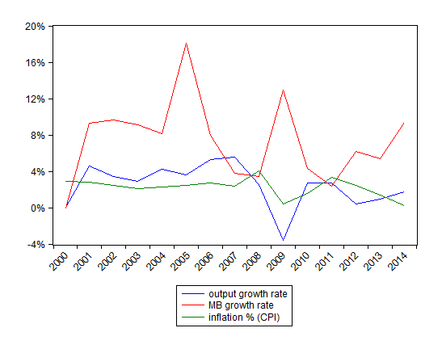
Figure 3. Annual Variation of GDP Growth, Inflation and MB in the EU: 2000-2014
A very weak correlation between the inflation rate and the MB growth rate
A weak correlation between real GDP growth rate and the MB growth rate

Slide 13
But in a recession, agents tend to hold cash and do not spend it
During the 2008 crisis, EU and MED private banks piled up liquidity without extending more credit and contributing to money creation (multiplier effect)
As a result, monetary base and M3 (the money stock) were disconnected from each other
This means that QE or money printing may not always lead to more money circulating in the real sector

Slide 14
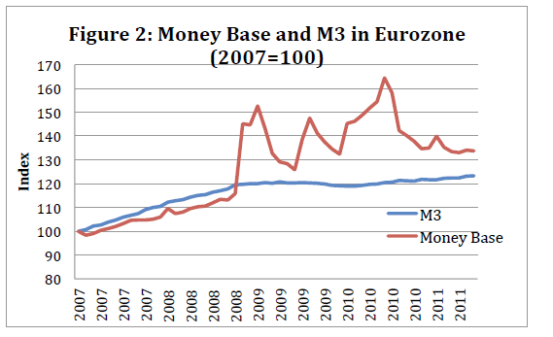

Slide 15
3. EU and MED Financial Market
EU and MED financial markets are dominated by commercial banks: securities markets are smaller relative to the banking system
Bank loans influence the real economy (consumption and investment)
However Banks became risk averse after the 2008 crisis →If QE does not stimulate banks’ lending → no effect on consumption and investment

Slide 16
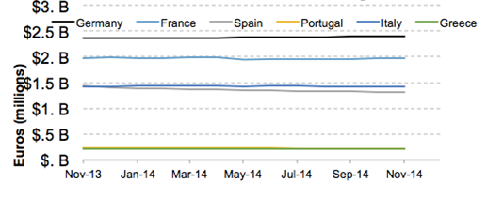
Figure 5. Growth in Lending: 2013-2014
Source: Eurostat, 2015

Slide 17
4. The Role of the Private Sector
Monetary Policy will remain ineffective as long as expectations of the private sector are not adjusted positively
Consumer and business confidence are very low in EU and MED countries
Greek Debt crisis is negatively affecting the behavior and expectations of businesses and consumers
Austerity measures are negatively affecting aggregate demand and the growth rate of GDP
Stagnant wages and high unemployment rates are adversely affecting domestic demand

Slide 18
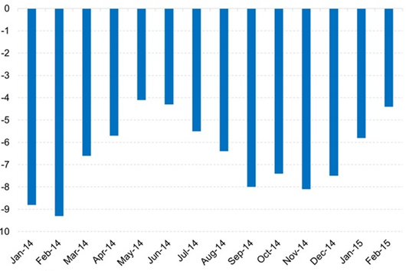
Figure 6. Monthly Consumer Confidence Index: 2014-2015
Source: Eurostat, 2015

Slide 19
5. Exchange Rate Channel: Depreciation of the Euro
With fixed exchange rates, MED countries (Jordan and Lebanon) cannot resort to the depreciation of their respective currencies
Egypt has recently floated its currency after consecutive devaluations
In the EU and by expanding the MB → QE is causing the depreciation of the euro which will subsequently stimulate exports
This will increase corporate earnings and firms’ profit
Will boost investment, hence GDP growth
Increase employment
Weak euro is expected to restore inflation and GDP growth

Slide 20
Exchange Rate Channel (cont.)
Japanese experience in 2012 highlights the success of the exchange rate channel in stimulating inflation and GDP growth
Japanese monetary base increased from 114 to 386 Trillion Yen (2012-2016)
Yen depreciated by 51% (2012-2015):79 to 121 Yen/$US
Boosted Japanese exports
Increased GDP growth rates to 2% in 2012 (From a negative)
And restored inflation to the 2.7% target (2014)
QE in the EU would be effective through the exchange rate channel because the share of EU’s exports in GDP is high However: is a 20% devaluation of the euro enough?

Slide 21
6. Macroeconomic Dynamics of EU and MED Public Debts
D is public debt
r is the long run real interest rate (nominal rate minus inflation)
SP is budget balance (positive or negative)
t denotes time

Slide 22
Expressing debt in terms of GDP (Y):
Note that current GDP depends on last period’s GDP plus its growth rate g:
Substituting and rearranging:

Slide 23
How can we stabilize debt? If debt is stable then
AND
Note that when g is close to zero, the above expression can therefore be approximated as:
Debt depends on the spread between interest rate r and the growth rate of GDP, g:
If g>r, then debt stabilizes even with a deficit
If r=g, then debt stabilizes when the budget is balanced
If r>g, debt keeps growing even if the budget balance is positive!

Slide 24
Long run interest rates r are increasing in the EU and MED regions and economic growth g is close to zero
r>g: debt keeps increasing even with a positive government budget balance
European austerity measures will fail to decrease debt + have a negative impact on g => higher interest rates (downgrading)
This further increases (r-g), making debt reduction even more difficult
Austerity measures are creating a trap whereby recessionary budgets, high interest rates and debts are reinforcing each other

Slide 25
Fiscal consolidation should first ensure that r is lower than g (g>r)
Lowering interest rates (QE by the ECB, floating exchange rate in Egypt, and restore private sector’s confidence)
Increase economic growth
Adjust budget balance accordingly (in the short run governments could even maintain a moderate debt-decreasing deficit which would sustain economic growth)
This constitutes the best policy response for debt reduction

Slide 26
7. Conclusion
Absence of fiscal space in most MED and EU countries due to the accumulation of large public debts and recurrent budget and current account deficits
Ineffectiveness of monetary policy in the presence of fixed exchange rates and free capital movements in most MED countries
This boils down to no role for government policies (fiscal and monetary) to deal with the current macroeconomic imbalances paving the way for future fiscal and currency crises
Reduce the public sector in favor of the private sector
Channel liquidity to the private sector through loans and encourage investments in productive ventures
Reduce government spending and increase supply side taxes

Slide 27
Conclusion (Cont’d)
EU’s and MED economies appear to be in a bind:
Past accumulated public debts and large budget and current account deficits
Bureaucracy, protectionist laws , restrictive labor laws
Consequences of 2008 financial crisis and 2010 Arab spring
Austerity measures and the prolonged tightening of fiscal policy
Lack of a political and fiscal union
Doubts about the success of QE
BREXIT which could lead to more exits from the EU
Monetary Policy will be ineffective as long as Banks remain in poor shape
They are slow in raising capital
They are readjusting their B/S to abide by Basel Accords
They have no incentive to extend loans
So far they have invested cash received from QE in securities and in T-Bills in most MED countries

Slide 28
Conclusion
Given the ineffectiveness of both monetary and fiscal policies, the private sector needs to take a leading role in addressing macroeconomic imbalances
Improve private sector’s expectations in both the EU and MED
Encourage commercial banks to give out more loans (to SMEs)
All the above would increase the growth rate of GDP and would render debt more sustainable
Once the above is achieved, introduce austerity and structural adjustment measures
This will insure sustainable economic growth and will reduce the likelihood of a future debt and currency crisis

Slide 29
Conclusion (Cont.)
EU must acknowledge the importance of fiscal policy in a monetary union
For those EU and MED countries with fiscal space: use expansionary fiscal policy
Stimulate growth
Increase employment
Correct wages
Restore inflation
Boost domestic demand

Slide 30
THANK YOU!

