Slide 1
Corporate performance in transition in the MENA region
FEMISE Annual Conference
13 and 14 February 2016
Hotel Grande Bretagne
Athens, Greece
Inma Martínez- Zarzoso*, Mona Said**
Laura Márquez*, Chari Mertzanis**, Maria Parra*
*IEI University Jaume I in Castellón (Spain), **The American University in Cairo

Slide 2







Aim of the project
Identify the main obstacles that companies face to do business in MENA countries
Investigate empirically to what extent these obstacles affect firms’ performance, including economic and non-economic factors
Notes:
Main aim: Empirical evaluation of the potential factors that might induce changes in corporate performance in the MENA region
Role of business environment: legal, regulatory, financial and institutional factors
Direct impact through the factors that affect production cost and firms’ sales: labor regulations, labor turnover, etc.
Indirect impact through the factors that affect overall macroeconomic performance and in turn firms’ sales. As institutions, unions, culture
All these factors combine to produce the environment within which firms operate, invest and grow

Slide 3
Motivation
The identification of the obstacles that affect firm performance is essential to design actions aimed at removing or reducing them
Since 2011, MENA countries have been involved in a major political and social transitional period:
Initial aim was to generate economic and social opportunities to pave the way towards economic growth and employment growth in a democratization context
But now facing major challenges to improve past trends and create new economic opportunities
Identifying the main constrains that difficult firms’ operations is an important objective: Does these constrains differ by country? Could policy interventions help? Regional, national level
Notes:
Identify the main obstacles that are …..
As we know

Slide 4
Investment climate literature
Previous literature
Dethier et al (2010)
Good business climate favours growth by encouraging investment and productivity growth
Business climate mainly affects economic activity throughout its influence on incentives to invest
Kinda et al (2011)
TFP in Morocco, Saudi Arabia, Algeria, Egypt, Lebanon, main constrains are workers education, internet access
Augier et al (2012)
Moroccan firms, finance and taxes are the main constrains
Notes:
The literature that analyse the effect that Inventment climate or businees environmental obstacles on economic and firm’s growth obtain.

Slide 5
Investment climate literature
Variables used to define the investment climate are generally related to infrastructure, security, political stability, access to finance and the regulatory and legal framework
Previous findings:
Poor infrastructure affects negatively firm performance
Alby et al (2010), Aterido and Hallward Driemeier (2007), Datta (2008)
Competition affects positively and excessive regulation affects negatively firms’ performance
Beck et al (2005), Gelb et al (2007), Aterido et al (2011)
Financial constraints affects negatively enterprise growth
Aterido and Hallward Driemeier (2007), Beck et al (2005)
Corruption and crime affects negatively firm performance
Fisman and Svensson (2007)
Notes:
Variables normally used to…and some authors find using empirical reseach

Slide 6
Data
Firm-level data are obtained from the World Bank Enterprise Survey dataset (WBES)
Formal (registered) companies with at least 5 employees are targeted for interviews, those with 100% government/state ownership are not eligible to participate in the survey
Business owners and top managers answered the survey
The questions cover a broad range of business environment topics including: sales, exports, workers and labour market, access to finance, corruption, infrastructure, competition… etc
Macro data: WDI, WB Economic Outlook, UN-COMTRADE
Institutions: WB Governance Indicators, Freedom House,
Constrains at the country level: WB Doing Business
Notes:
To conduct our research, we employ firm level data from the ….. The ES are an ongoing project since 2005 which involves the collection of both objective data based on firms’ experiences and enterprises’ perception of the environment in which they operate. The data are based on firm-level surveys and have evolved into a mature stage that uses a standardized methodology of implementation, sampling and quality control in most of the World Bank’s client-countries.Our firm-level data, in addition to the MENA countries and their firms, will cover thousands of firms in other developing and developed economies

Slide 7
Methodology
First step: Measuring economic performance→ TFP, labour productivity, sales growth
Second step: Measuring constrains→
Firm level: Size, sector, ownership, internet access, perceived constrains
Macro-level: Macro-financial and macro-economic factors
Non-economic factors: Rule of law, human development, governance quality
Third step: Modelling strategy
TFP semi-parametric panel-data estimation when possible
Determinants of TFP, LP, sales growth→ panel-data, Probit
Country level: panel-data FE, quantile regression
Notes:
First, the impact of firm-level characteristics will be examined (firm size, firm sector, ownership structure, export orientation, etc.)
Second, the impact of macro-economic factors of each country will be considered reflecting the impact of overall economic development of a country (economic growth, distribution of income, etc.)
the impact of macro-financial factors of each country will be considered reflecting the impact of overall financial development of a country (credit provision, financing constraints, bank efficiency, etc.). Third, the impact of non-economic factors of each country will be considered reflecting the impact of institutions, culture, and human capital (rule of law, human development, governance quality, etc.)

Slide 8
Progress: Egypt results
3,129 firms for the years 2004, 2005 and 2007
554 firms report data for the 3 years
Some questions are also answered for the current and the previous year
We construct a panel from 2003 to 2007
obtaining 2,770 observations, 34 outliers excluded
Notes:
We only use data from manufactued firms but our initiial aim was use manufacures and services to compare both sectors, but data from services are not fully available.
We start with….
We select …to can constuct a panel from 2003 to 2007

Slide 9
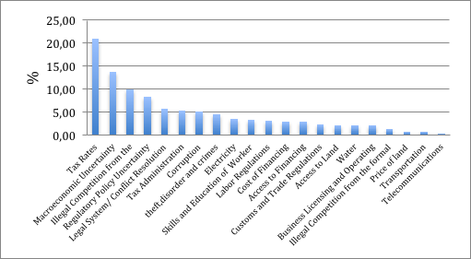
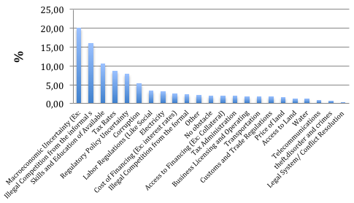
Egyptian firms’ perception of obstacles
Figure 1. Main obstacles quoted by Egyptian firms in 2004 and 2007
Source: World Bank Enterprise Survey; Author calculations
Notes:
In the questionaire firms report their perception about the main obtacles for the operation and growth of the company. And a list of 21 topic are available to the respondent.
As we can observe the main obstacles for the majority of the manufactures egyptian firms are Tax rates, Macroeconomic uncertainity, Illegal competition from the informal sector and regulatory uncertainty.

Slide 10
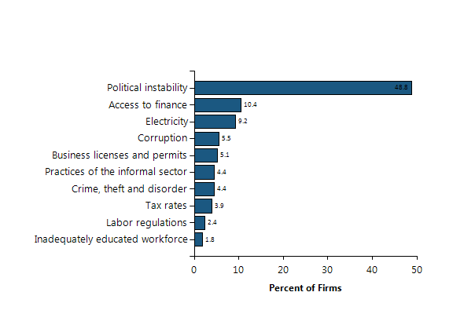
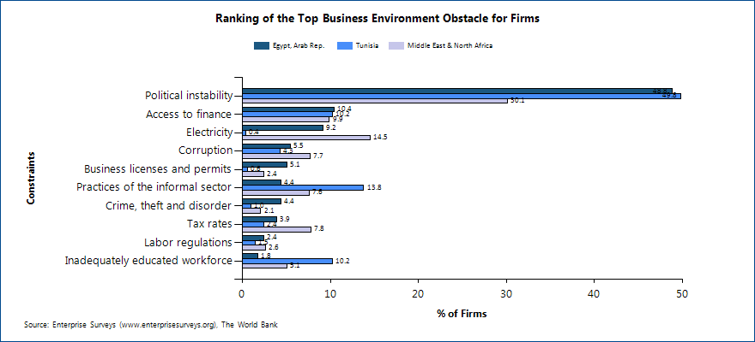
Egyptian firms’ perception of obstacles, comparison
In 2013:

Slide 11
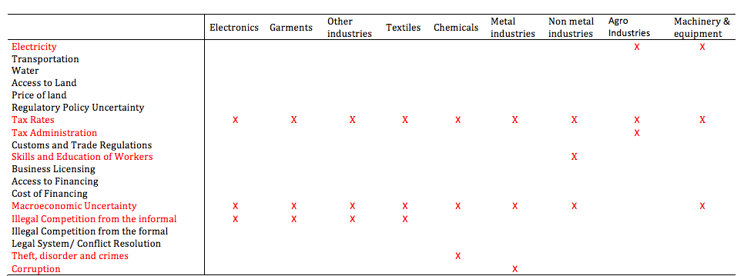
Egyptian firms’ perception of obstacles for their growth by Industry
Do Industry affect firm obstacles perception?
Figure 2. Main obstacles quoted by Egyptian firms in 2004 by industry
Notes:
If we analyse these responses taking into account the industry wich the compay belongs we obtain, some different patterns. Obtaining that in general the obstacle common in all industries are tax rates, Following by Macroeconomic Uncertainity, Than Electronic, Garment Other industries and Textil report similar patterns of obstacles where ilegal competition from the informal sctor are importat. For chemicals are importat Theft,disorders and crimes, Corruption for Metal industries, Skills and efuction of workers for non metal industries and electricity are important in agro industries and machinary and equipment
This results indicate that obstacles are affecting in a different way the different industry so we need take into account in our estimations

Slide 12
Firms characteristics and business obstacles
Table 5. Firm characteristics and business environmental obstacles (OLS- Regression)
Dep Var: | crime | laws | Ilegalcomfor | Ilegalcom info | corrupt | macroe | finacc | fincost | licence | Skills
MEs | -0.051 | -0.068 | -0.182 | -0.274*** | -0.138 | 0.094 | -0.416** | -0.394** | -0.107 | -0.013
 | 0.083 | 0.108 | 0.125 | 0.100 | 0.092 | 0.082 | 0.163 | 0.162 | 0.082 | 0.097
LGs | -0.076 | -0.242* | 0.064 | -0.036 | -0.002 | 0.062 | -0.229 | -0.329 | -0.049 | 0.135
 | 0.097 | 0.133 | 0.146 | 0.124 | 0.114 | 0.101 | 0.211 | 0.211 | 0.101 | 0.119
exp | 0.069 | 0.173 | -0.125 | -0.022 | 0.019 | -0.019 | 0.055 | 0.105 | -0.101 | -0.083
 | 0.090 | 0.114 | 0.135 | 0.104 | 0.098 | 0.086 | 0.169 | 0.170 | 0.085 | 0.101
for1 | -0.022 | -0.191 | -0.055 | 0.126 | -0.071 | -0.274 | -0.687* | -0.946*** | 0.070 | 0.095
 | 0.164 | 0.226 | 0.248 | 0.210 | 0.189 | 0.169 | 0.367 | 0.359 | 0.170 | 0.201
cons | 0.424*** | 1.218*** | 1.179*** | 2.734*** | 2.363*** | 3.036*** | 2.305*** | 2.646*** | 0.956*** | 1.852***
 | 0.041 | 0.055 | 0.062 | 0.055 | 0.046 | 0.042 | 0.096 | 0.093 | 0.043 | 0.051
obs | 1028 | 2529 | 1020 | 2549 | 2566 | 2566 | 1928 | 1935 | 2573 | 2575
rmse | 0.887 | 1.740 | 1.305 | 1.543 | 1.542 | 1.333 | 2.045 | 2.075 | 1.301 | 1.550
Notes: The dependent variable in each column is the business obstacle. Robust standard errors reported,*** p<0.01, **p<0.05, * p<0.1. Industry and year dummies included. Omitted variable for firm size are SMs, that takes value 1 if firm have between 5 and 50 workers.
Notes:
We obtain than ilegal competition from informal sector affects more small firms than medium

Slide 13
Firms characteristics and business obstacles
Table 5. Firm characteristics and business environmental obstacles (OLS- Regression)
 | laborreg | customs | taxadm | taxrate | policy | landpr | landacc | water | trans | elec | tel
MEs | -0.100 | -0.439*** | -0.166* | -0.246*** | -0.185* | -0.254* | -0.272* | -0.149 | -0.022 | 0.062 | -0.093
 | 0.089 | 0.159 | 0.101 | 0.093 | 0.096 | 0.148 | 0.142 | 0.120 | 0.068 | 0.087 | 0.060
LGs | 0.044 | -0.724*** | -0.368*** | -0.381*** | -0.293** | -0.159 | -0.168 | -0.264* | 0.152* | 0.040 | -0.028
 | 0.110 | 0.206 | 0.124 | 0.115 | 0.119 | 0.188 | 0.177 | 0.151 | 0.084 | 0.107 | 0.074
exp | 0.051 | 0.663*** | 0.169 | 0.234** | 0.021 | -0.050 | -0.113 | -0.019 | -0.110 | -0.084 | 0.176***
 | 0.093 | 0.166 | 0.107 | 0.100 | 0.101 | 0.152 | 0.148 | 0.124 | 0.071 | 0.089 | 0.062
for1 | 0.173 | -0.174 | -0.234 | -0.264 | -0.015 | -0.392 | -0.490 | 0.197 | -0.047 | -0.124 | 0.018
 | 0.184 | 0.347 | 0.211 | 0.196 | 0.200 | 0.320 | 0.304 | 0.256 | 0.141 | 0.183 | 0.126
cons | 1.393*** | 2.360*** | 2.101*** | 2.707*** | 2.625*** | 2.093*** | 1.849*** | 1.115*** | 0.585*** | 1.090*** | 0.316***
 | 0.046 | 0.095 | 0.051 | 0.045 | 0.050 | 0.081 | 0.078 | 0.067 | 0.036 | 0.048 | 0.033
obs | 2577 | 2061 | 2554 | 2557 | 2552 | 2158 | 2284 | 2374 | 2572 | 2579 | 2564
rmse | 1.437 | 2.107 | 1.646 | 1.601 | 1.548 | 2.054 | 2.047 | 1.769 | 1.081 | 1.336 | .922
Notes: Robust standard errors reported*** p<0.01, **p<0.05, * p<0.1. Industrial and year dummies included. Omitted variable for firm size are SMs, that takes value 1 if firm have between 5 and 50 workers.

Slide 14
Empirical Strategy
Dependent variable:
Total Factor Productivity
We also use:
Average number of workers
Total sales
Explanatory variables:
IC _{i, 2004}= Variables measuring investment climate constrains taking values from 0 to 4
lworkt _{i, t-2 =} Average number of permanent workers
For1 _{i,t =} Dummy variable that takes value of 1 if a firm is owned by foreigners
Notes:
In order to investigate how these obstacles are affecting firm performance of Egyptian firms, we estimate the following equations
Where the dependent variable is TFP and also we run a sensivity analysis using as dependent variables the average number of workers and also total sales
To avoid multicolineality we follow a sequential estimation and include each investment climate variable one by one. We also include as control variables, the size of firm measured as the average number of workers and if firm are owned by foreigners. To avoid endogeneity we use lagged values of workers and we use values of investment climate variables in 2004.
Industry and time dummies are also included to proxy for factors that are industry speciffuc and time invariant and factors that vary over time and are common to all firms.
The equation isn estimating using panel data techniques . Firm Fixed effects

Slide 16
Preliminary Results (TFP)
Table 6. Impact of Business Obstacles on TFP (dep. Var ln TFP)
IC in each model: | IC | lworkt_2 | foreignowner | cons | obs | R²
finacc4 | -0.062*** | 0.392*** | 0.021*** | 5.965***
 | (0.019) | (0.039) | (0.004) | (0.456) | 1.488 | 0.33
fincost4 | -0.047** | 0.391*** | 0.021*** | 5.987***
 | (0.020) | (0.039) | (0.004) | (0.460) | 1.488 | 0.33
taxrate4 | -0.072* | 0.397*** | 0.021*** | 6.136***
 | (0.039) | (0.039) | (0.004) | (0.480) | 1.492 | 0.33
policy4 | -0.067** | 0.388*** | 0.022*** | 6.044***
 | (0.032) | (0.039) | (0.004) | (0.465) | 1.486 | 0.33
landpr4 | -0.033* | 0.395*** | 0.021*** | 5.898***
 | (0.020) | (0.039) | (0.004) | (0.458) | 1.486 | 0.33
water4 | -0.055*** | 0.391*** | 0.021*** | 5.924***
 | (0.021) | (0.039) | (0.004) | (0.456) | 1.492 | 0.33
elec4 | -0.081** | 0.395*** | 0.022*** | 6.138***
 | (0.035) | (0.039) | (0.003) | (0.471) | 1.492 | 0.33
Notes: Dependent variable is TFP. Standard errors in brackets where *** p<0.001, **p<0.05, * p<0.01. Industrial and year dummies included, it is obtained using Levinsohn and Petrin (2003) procedure; lworkt_2_{i,t -2} means the average number of workers lagged in two periods and foreignowner _{i,t} are a dummy variable that take value 1 if the firm is owned by foreigners and 0 otherwise. time and industrial dummies are nor reported to space restrictions
Notes:
I only repport the obtacles that appears statistically significant, due to space restictions .
And as we can observe the main obstacles that are affecting the most egytpain TFP are access and cost to finance, tax rates, policy uncertainity , land price, and two infrastuctures namely water and electriciy.

Slide 17
Preliminary Results (Total sales)
Table 7. Impact of Business Obstacles on total sales
IC in each model: | IC | lworkt_2 | foreignowner | cons | obs | R²
finacc4 | -0.070*** | 0.549*** | 0.025*** | 6.677***
 | (0.022) | (0.045) | (0.004) | (0.532) | 1.491 | 0.33
fincost4 | -0.054** | 0.549*** | 0.026*** | 6.705***
 | (0.023) | (0.045) | (0.004) | (0.536) | 1.491 | 0.34
taxrate4 | -0.080* | 0.556*** | 0.026*** | 6.862***
 | (0.046) | (0.045) | (0.004) | (0.561) | 1.495 | 0.34
policy4 | -0.072* | 0.545*** | 0.027*** | 6.759***
 | (0.038) | (0.046) | (0.004) | (0.543) | 1.489 | 0.34
water4 | -0.066*** | 0.548*** | 0.026*** | 6.635***
 | (0.024) | (0.045) | (0.004) | (0.532) | 1.495 | 0.34
elec4 | -0.089** | 0.553*** | 0.026*** | 6.864***
 | (0.041) | (0.045) | (0.004) | (0.550) | 1.495 | 0.34
Notes: The dependent variable is total sales in year t. Standard errors are in brackets where *** p<0.01, **p<0.05, * p<0.1. Industrial and year dummies included, TFP it is obtained using Levinsohn and Petrin (2003) procedure; lworkt_2_{i,t -2} is the average number of workers lagged two periods and foreignowner _{i,t} is a dummy variable that take value of 1 when the firm is owned by foreigners, 0 otherwise
Notes:
If we use total sales as a measure of firm performace included as dependent variable. We obtain similar results, with the only exception of land price, which is not any longer significant

Slide 18
Preliminary Results (workers)
Table 8. Impact of Business Obstacles on the average number of workers
IC in each model: | IC | lsales_2 | foreignowner | cons | Nobs | R²
finacc4 | -0.032* | 0.169*** | 0.014*** | 2.847***
 | (0.018) | (0.020) | (0.003) | (0.454) | 1.387 | 0.58
fincost4 | -0.032* | 0.169*** | 0.014*** | 2.877***
 | (0.019) | (0.020) | (0.003) | (0.456) | 1.387 | 0.58
water4 | -0.055*** | 0.167*** | 0.015*** | 2.860***
 | (0.020) | (0.020) | (0.003) | (0.451) | 1.393 | 0.58
Notes: The dependent variable is the average number of workers in year t. Standard errors in brackets where *** p<0.01, **p<0.05, * p<0.1. Industrial and year dummies included, it is obtained using Levinsohn and Petrin (2003) procedure; lworkt_2_{i,t -2} is the average number of workers lagged in two periods and foreignowner _{i,t} are a dummy variable that take value 1 if the firm is owned by foreigners and 0 otherwise
Notes:
If we use size of the firm as measure of firm performance. We find that those obstacle that remain statistically significant are access and cost to finance and water.

Slide 19
Findings
Tax rates, access to and cost of finance, political uncertainty, price
of land and water and electricity are the most important constrains affecting the TFP of Egyptian firms
Our results are in line with descriptive results obtained by Doing Business Report (2013), focused on Egyptian economy
Egypt is ranked at position 128 of a total 189 economies meaning that obstacles to do business in Egypt are important
Egypt is ranked at position 105 of 189 economies on the ease of getting electricity
Egypt is ranked at position 148 of 189 economies on the ease of paying taxes. (Taxes represent a 42% of firms profits)
Access to reliable and affordable electricity is crucia for businesses and in Egypt, getting electricity requires 7 procedures, takes 54 days and costs 337.4% of income per capita

Slide 20
Policy implications
Preliminary results:
Policies that improve access and cost of soft basic infrastructures like electricity and water are needed
Improvements on access and cost to finance to facilitate economic growth and employment

Slide 21
Findings
Preliminary results for other countries:
Main constrains
Lebanon (2005): Macroeconomic instability
Morocco (2006) : Tax rates, tax administration
Morocco (2013): Political uncertainty, access to finance
Jordan (2006) : Political uncertainty
Jordan (2013): Political uncertainty, access to finance, corruption, crime, informal sector, legal constrains
Tunisia (2013): Political uncertainty, access to finance, corruption, crime, labour regulations, inadequate skills, macro-stability
Next step: Compare with WB Doing Business data
Notes:
Morocco: 125 firms, Jordan: 196, Lebanon: 465.

Slide 22
Thank you for your attention

Slide 23
WB doing business

Slide 24
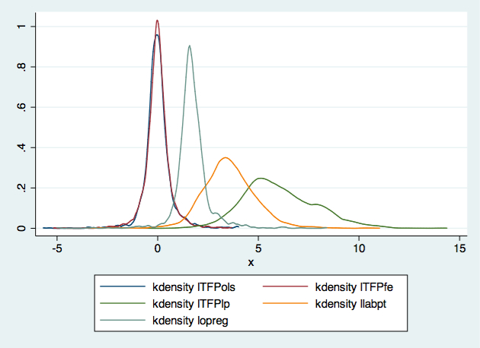
TFP estimates

Slide 25
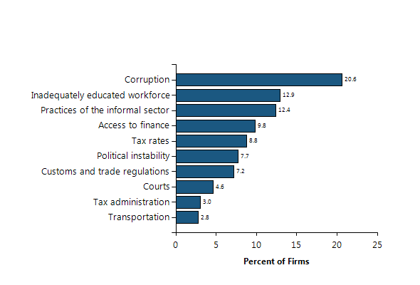
Morocco 2013

Slide 26
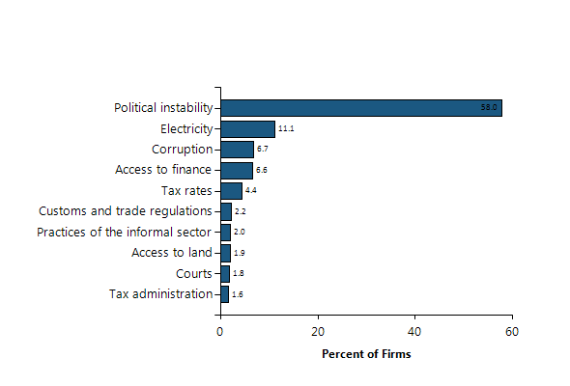
Lebanon 2013

Slide 27
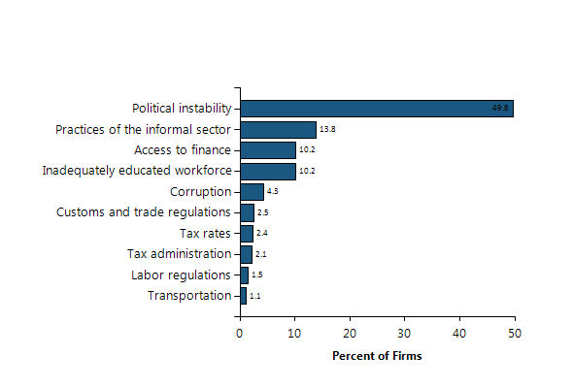
Tunisia 2013

Slide 28
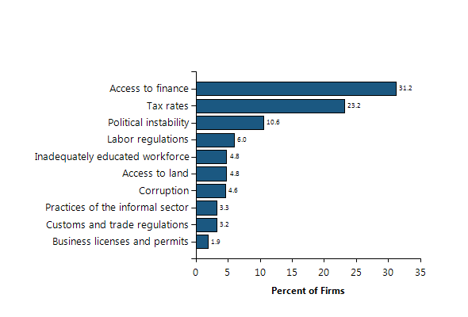
Jordan 2013

Slide 29
WBES
Sampling and weights:
The sampling methodology for Enterprise Surveys is stratified random sampling. In a simple random sample, all members of the population have the same probability of being selected and no weighting of the observations is necessary. In a stratified random sample, all population units are grouped within homogeneous groups and simple random samples are selected within each group. This method allows computing estimates for each of the strata with a specified level of precision while population estimates can also be estimated by properly weighting individual observations. The sampling weights take care of the varying probabilities of selection across different strata. Under certain conditions, estimates' precision under stratified random sampling will be higher than under simple random sampling (lower standard errors may result from the estimation procedure).
The strata for Enterprise Surveys are firm size, business sector, and geographic region within a country. Firm size levels are 5-19 (small), 20-99 (medium), and 100+ employees (large-sized firms). Since in most economies, the majority of firms are small and medium-sized, Enterprise Surveys oversample large firms since larger firms tend to be engines of job creation. Sector breakdown is usually manufacturing, retail, and other services. For larger economies, specific manufacturing sub-sectors are selected as additional strata on the basis of employment, value-added, and total number of establishments figures. Geographic regions within a country are selected based on which cities/regions collectively contain the majority of economic activity.
Ideally the survey sample frame is derived from the universe of eligible firms obtained from the country’s statistical office.

