Slide 1
Innovation, Policy, Development
Concepts and Measurement
Jean-Eric Aubert
ERF/FEMISE Workshop
Cairo, January 18 2016

Slide 2
Key points
Innovation: What? What for? Employment challenges
Appraising innovation capabilities of countries
Innovation policy: key components and strategic implementation
Clusters and incubators

Slide 3
Innovation – What? What for?
Diffusion of (modest) newness in the economy in form of new products, new processes, new services… going generally with new business models, new organisational structures, etc. (more than 70 % digital tech-based)
Needed for maintaining or raising the competitiveness of industries, improving livelihoods, environment, etc.
Small improvements matter. Importance of Transformative Innovations: e.g. applications for facilitating woman employment in Saudi Arabia
What about innovation and job creation?

Slide 4
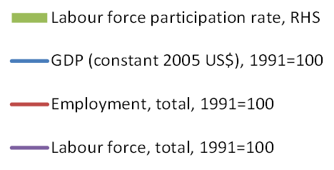
Threat to livelihoods: Jobless growth
Indexed GDP (constant 2005 USD), total employment and total labour force, 1991=100 (LHS); labour force participation rate, total in % of total population ages 15-64 (RHS)
Notes:
The world economy is deeply engaged in a long-term growth process that is not generating employment.
GDP and employment growth trends have been diverging over the last two decades in almost all countries, including the major OECD economies (United States shown in graph), the BRIICS (China shown in next graph) and certain low-income countries (Bangladesh shown in last graph).
This trend has been especially pronounced since the 2000s, reflecting the unemployment problems experienced by a number of countries, as well as significant productivity increases that release people from repetitive and boring tasks. In Brazil, the Russian Federation and South Africa, the trend of “jobless growth” has only emerged since around 2007/08, marking the beginning of the global economic crisis.
Looking forward, unemployment is seen as a major global risk for the next decade, and one which could have a significant impact, especially as it can translate into profound social instability.

Slide 5
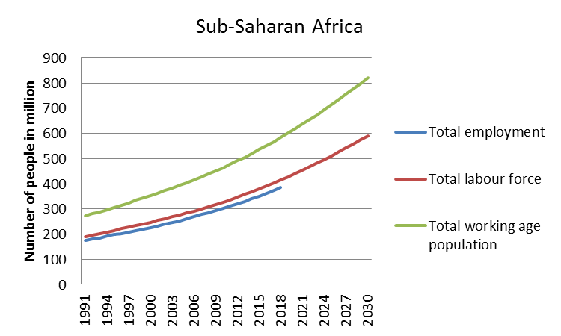
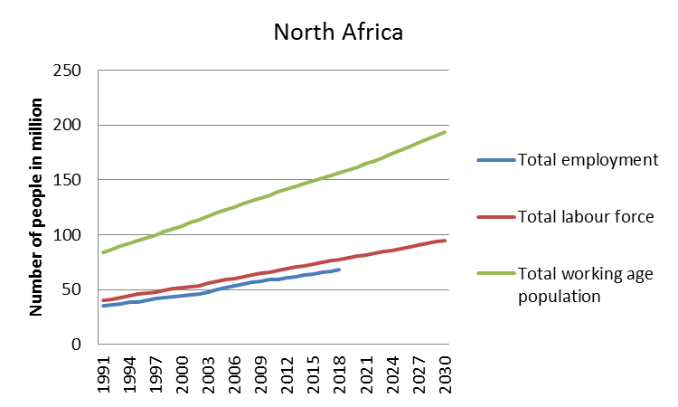
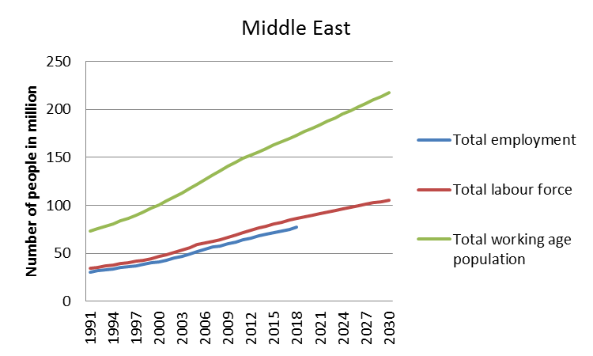
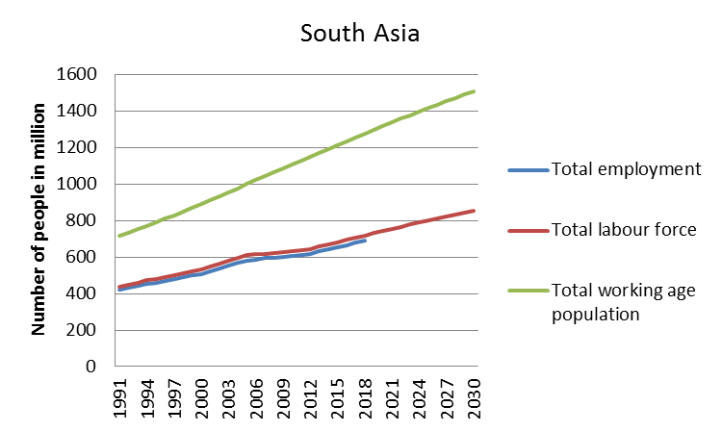
Emerging youth bulges pose a challenge to employment

Slide 6
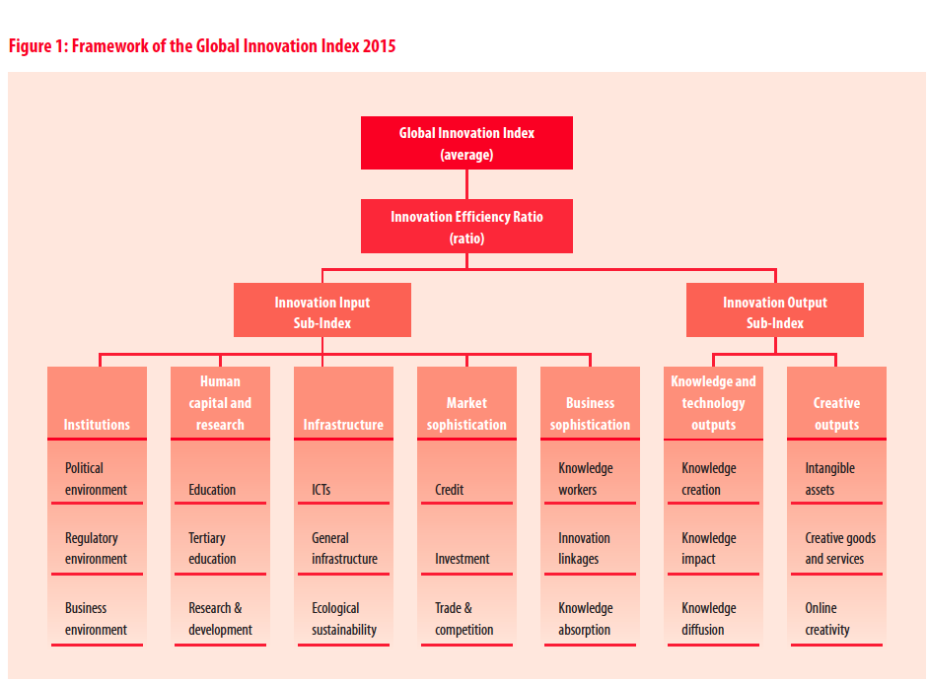

Slide 7
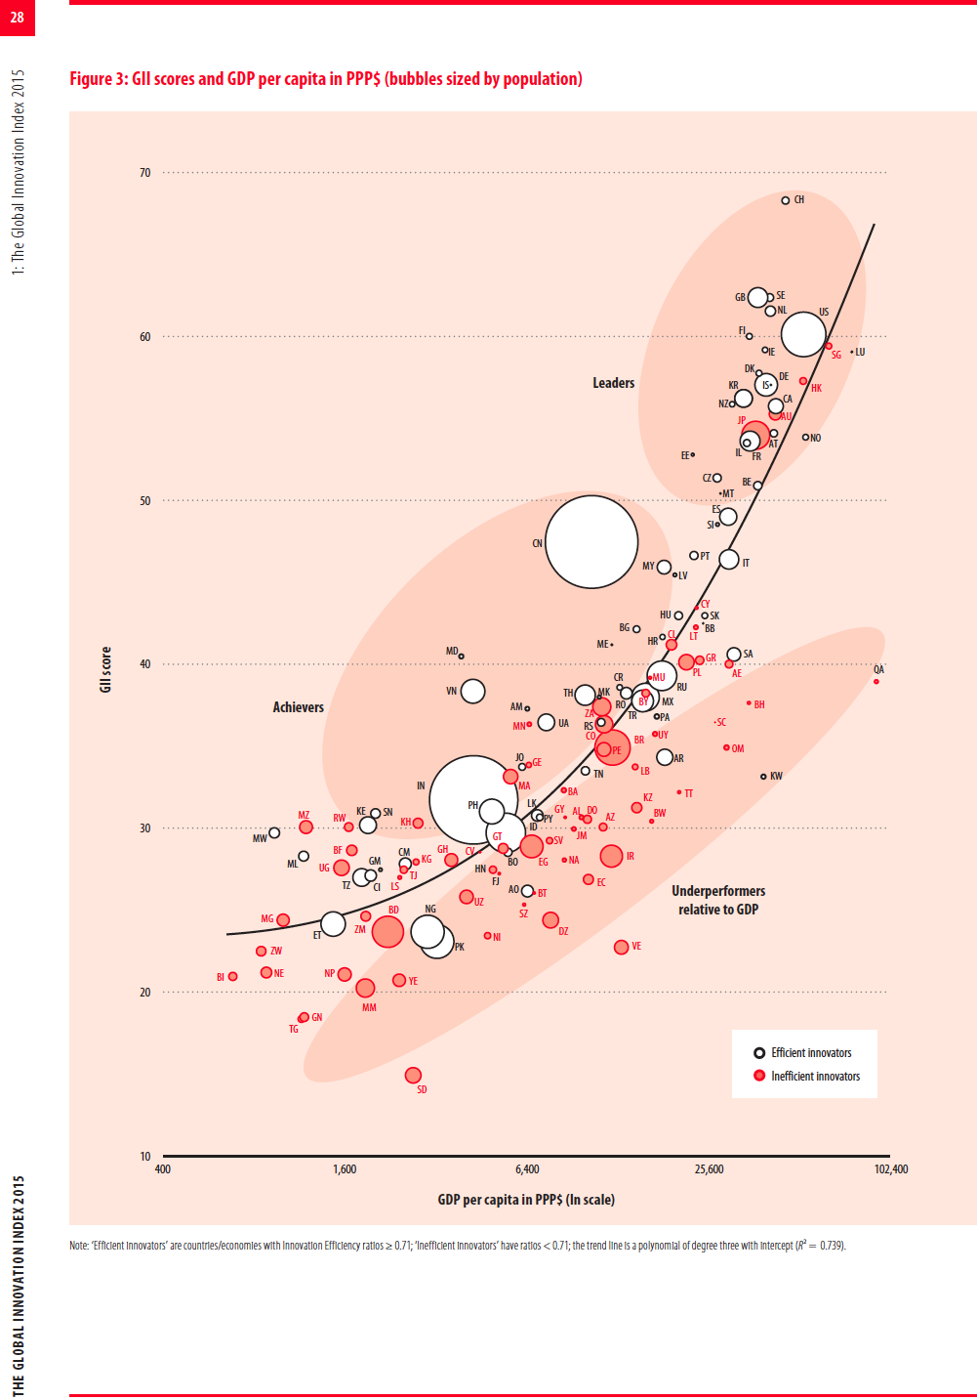

Slide 8
Innovation performance and GDP per capita: Arab Countries

Slide 9
Monitoring
Traditional: Indicators, Benchmarking
The future: Visualisation: thanks to new technologies; real time, evolving picture; issue: how to capture relevant information (providers?)

Slide 10
INNOVATION, DEVELOPMENT, SOCIETAL SYSTEMS
S.S
DS
I.S.
D.S
S.S.
JEA World Bank Institute/OECD

Slide 11
Innovation Ecosystems: Advanced economies vs other economies
Key features of advanced economies: fairly good “framework conditions”; innovation “islands”
Heterogeneity of innovation systems in medium income countries; inspiring success stories
Some lessons from low income countries: ICT examples, BOP innovations, “frugal” innovations.

Slide 13
Policy Priorities in Developing Countries
Knowledge bases: technical qualifications (vocational + polytechnics); adaptive R&D
Rules of the game: Obstacles: corruption, IP (open source)
Support: R&D collaboration schemes ; large scale programs; incubators
(Some success stories in Egypt)

Slide 14
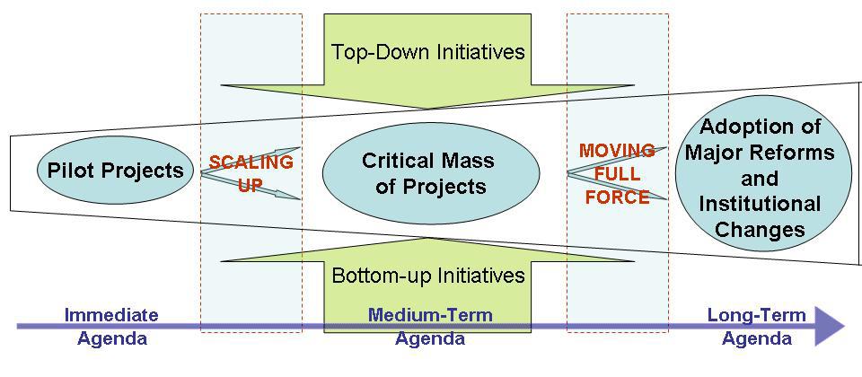
Innovation Government Strategy:
HOW TO CREATE A VIRTUOUS POLICY CYCLE? (China example)

Slide 15
Innovation dynamics

Slide 16
What is meant by ‘Clusters’? Examples
Local + Sectoral Concentration capturing significant shares of global/regional/national/local markets
High tech : Silicon Valley, Cambridge; ICT in Bangalore
Established/traditional sectors: Italian districts, LAC export pioneers
Small communities breathtaking stories: e.g. Iran Khorasan, 80% of world saffron; Husavik, Iceland, (main world observatory for whales)
Small villages providing large urban markets: e.g. Makoko village providing Lagos with fish

Slide 17
Incubating structures
Combining hosting/working spaces, fab labs for making/testing, crowd sourcing for funding
Offering mentoring and technical/legal/commercial assistance
Globally connected for information sourcing, partnership development, etc.
Need for boosting mechanisms (to join VC and other innovation financing sources)

Slide 18
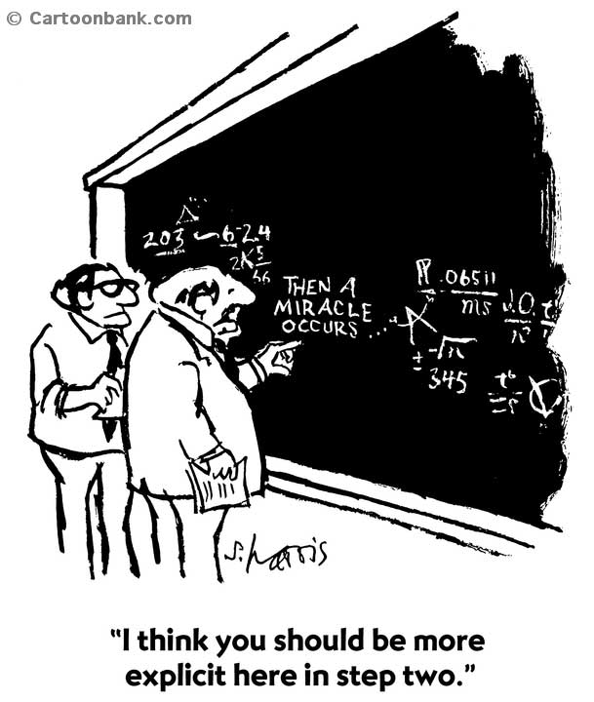
Sometimes economic development is more art than science

Slide 19
Thank you! aubert.jeaneric@gmail.com

