Slide 1



Innovation & Institutions in MENA:
Empirical & Practical Evidence
Presented by: Tamer Taha
ttaha@yomken.com

Slide 2
Challenges – Empirical Evidence

Slide 3
Special Settings in Southern Mediterranean Countries
Institutions
  Informal constraints
  Rent-seeking behavior
Source: World Enterprise Survey (2014)
Notes:
Therefore, this study is focusing on the MENA region which suffers from:
High level of informal constraints illustrated by the highest bribery incidence

Slide 4
Special Settings in Southern Mediterranean Countries
Institutions
  Informal constraints
  Rent-seeking behavior
Innovation
  Low performance
Data Source: Global Innovation Index, World Development Indicators (2014)
Notes:
The region is also performing weakly

Slide 5
Special Settings in Southern Mediterranean Countries
Institutions
  Informal constraints
  Rent-seeking behavior
Innovation
  Low performance
Employment
  Jobless growth
Source: ILO (2012)
Notes:
Given these facts my research aims at studying the linkages between institutions, innovation and employment…

Slide 6
Special Settings in Southern Mediterranean Countries
Innovation
Firm’s Growth
- +
Employment

Slide 7
Special Settings in Southern Mediterranean Countries
Social Capital
Institutional Constraints
Innovation
Firm’s Growth
- +
Employment

Slide 8
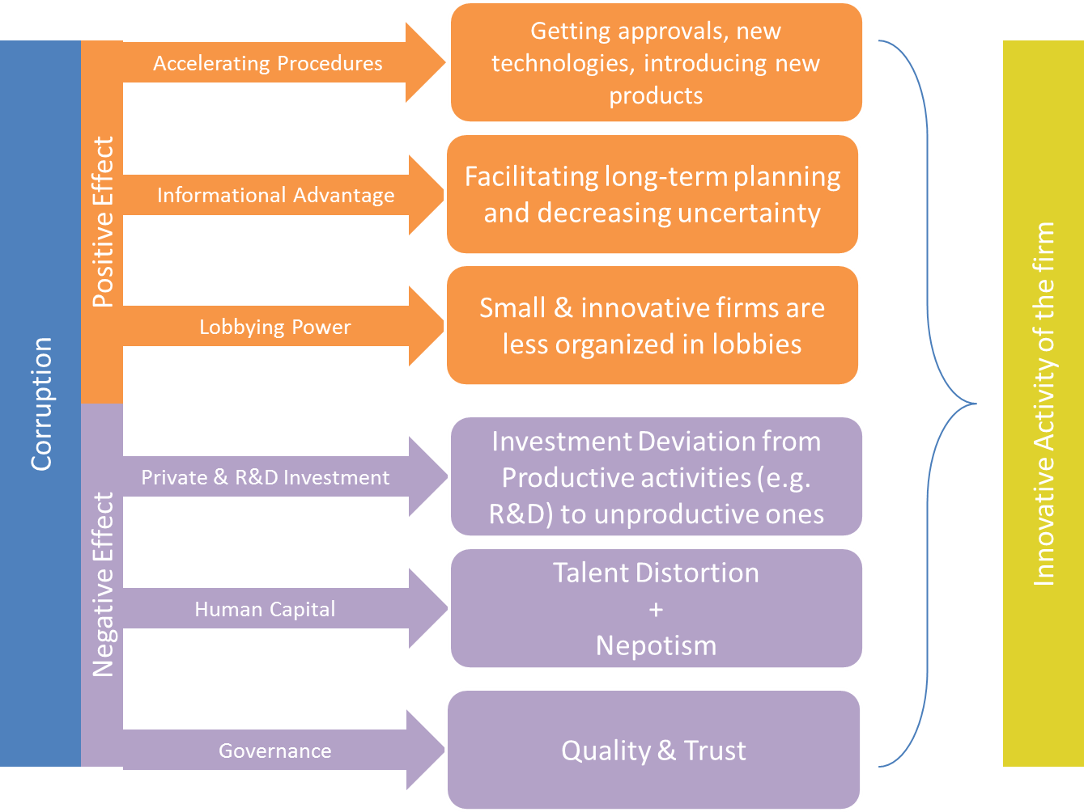
Special Settings in Southern Mediterranean Countries
Notes:
Beyond the moral considerations…
Negative:
1- Easy-to-plan activities (Baumol, 1990)-> Entrepreneurs prefer to invest to get close to bureaucrates and in trade instead of investing in riskier business
2- Trust is needded for high value added industries (Anokhin & Schulze, 2009)
3- Nepotism -> less diversification -> less innovation ((Lorenzo & Nunez-cacho, 2013).
However…
Positive (Greasing):
1- Get things done vs. bureaucracy esp. in countries with weak instutions -> see Fisman & Svensson, 2007
2- informational advantage lowers market uncertainty ((Lambsdorff, 2007).
3- new innovative firms don’t have any lobbies and not part of the elites in the governmetn (usually) -> outsider position pushes towards crruptive behavior

Slide 9
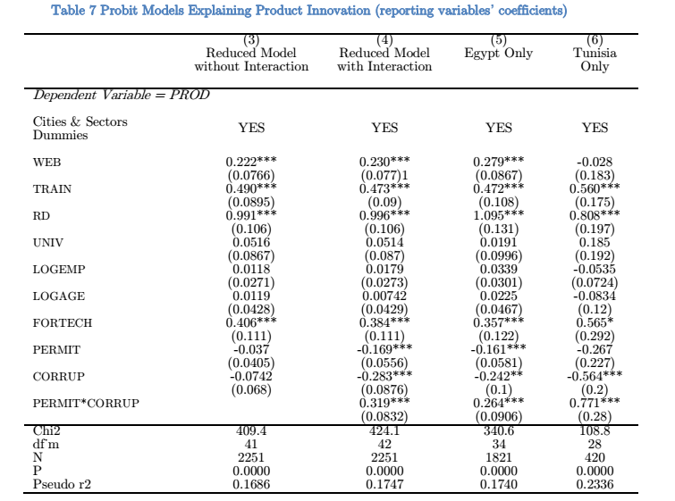
Corruption… “Greasing” effect?

Slide 10
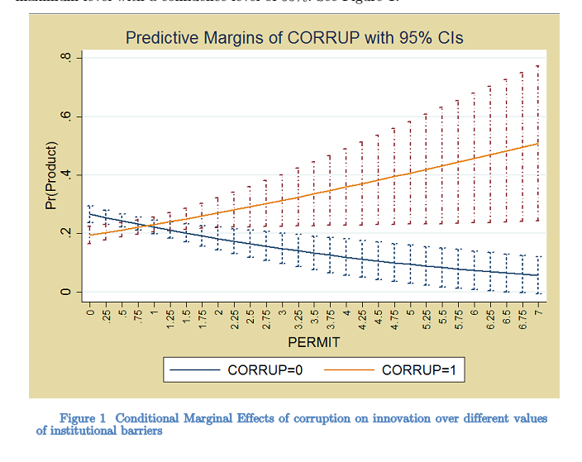
Corruption… “Greasing” effect?
Source: Taha T., upcoming

Slide 11
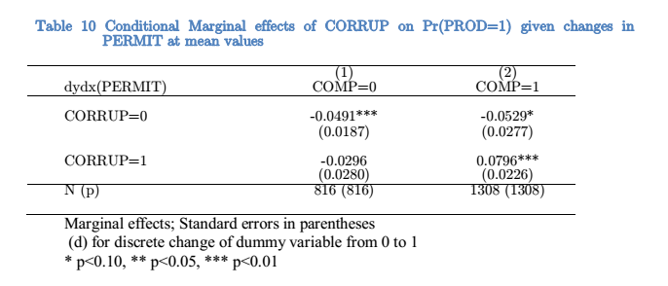
Corruption… “Greasing” effect?
Source: Taha T., upcoming

Slide 12
Research Quality & Collaboration with Industry
شكل 9 جودة المراكز البحثية وتوافر العلماء والتعاون بين الجامعات والصناعة في مصر مقارنة بالعالم
مصدر البينات: تقرير التنافسية العالمي 2012/2013
Notes:
Beyond the moral considerations…
Negative:
1- Easy-to-plan activities (Baumol, 1990)-> Entrepreneurs prefer to invest to get close to bureaucrates and in trade instead of investing in riskier business
2- Trust is needded for high value added industries (Anokhin & Schulze, 2009)
3- Nepotism -> less diversification -> less innovation ((Lorenzo & Nunez-cacho, 2013).
However…
Positive (Greasing):
1- Get things done vs. bureaucracy esp. in countries with weak instutions -> see Fisman & Svensson, 2007
2- informational advantage lowers market uncertainty ((Lambsdorff, 2007).
3- new innovative firms don’t have any lobbies and not part of the elites in the governmetn (usually) -> outsider position pushes towards crruptive behavior

Slide 13
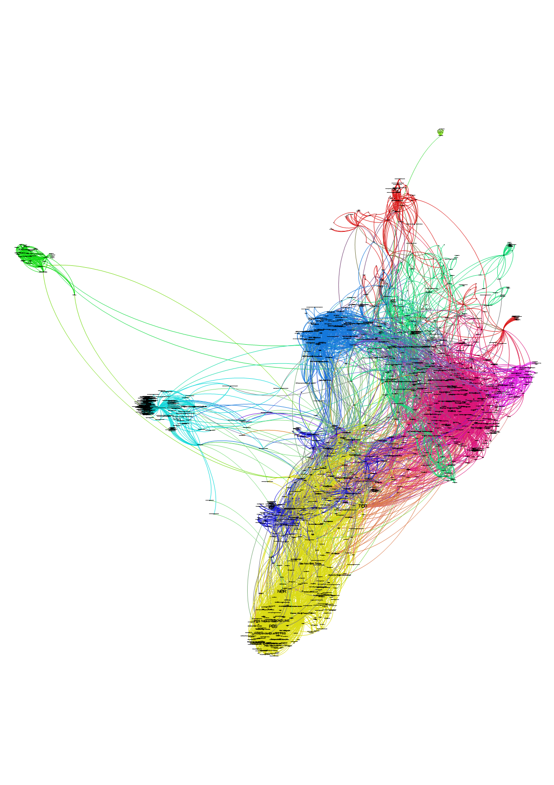
Meso-level: Disconnected Clusters
Source: Taha T., upcoming

Slide 14
Skills Mismatch
المصدر: نتائج استطلاع الرأي لقياس آراء أصحاب الأعمال حول احتياجات سوق العمل وكفاءة مخرجات قطاع التعليم العالي في مصر، 2009.
المصدر: الجهاز المركزي للتعبئة العامة والإحصاء. 2012.
شكل 5 الفرق بين احتياجات السوق من التخصصات المعرفية و مخرجات التعليم العالي

Slide 15
Most Innovative Sectors in MENA?
Labor-Intensive

Slide 16
Innovation facing global trends
2010’s
20
15
10
5
% of Profit per Unit
1970’s
Fabrication
Marketing
& Branding
Production Chain
Distribution
After-Sales
Product Design
Research & Development
Product Conceptualization
Source: Stan Shih. 1998

Slide 17
Solving these challenges pragmatically… Yomken!
Impact Evaluation
Feasibility Studies & Technology Due Diligence
Yomken.com

Slide 18
Solving these challenges pragmatically… Yomken!
Impact Evaluation
Feasibility Studies & Technology Due Diligence
Yomken.com

Slide 19
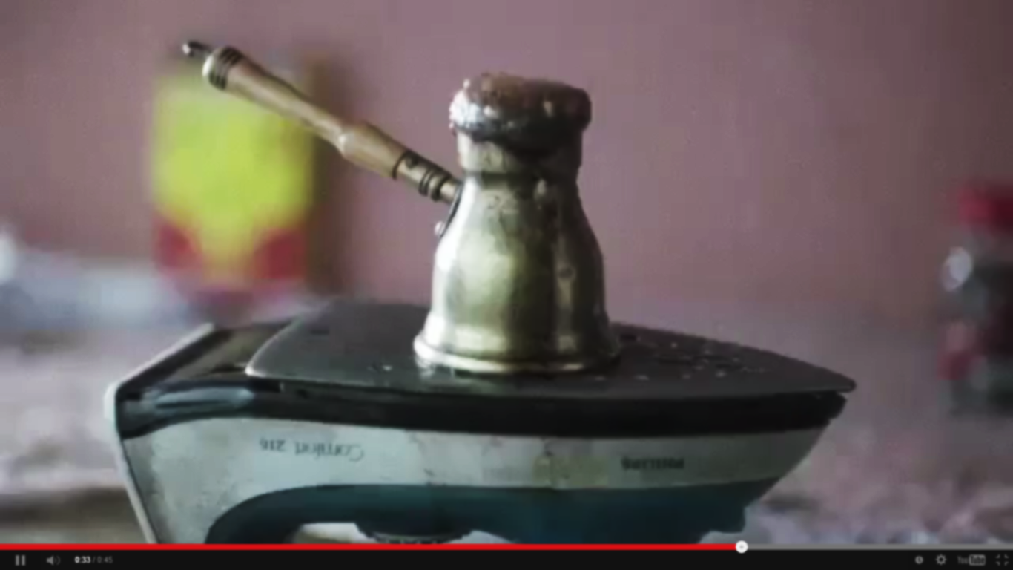


Slide 20
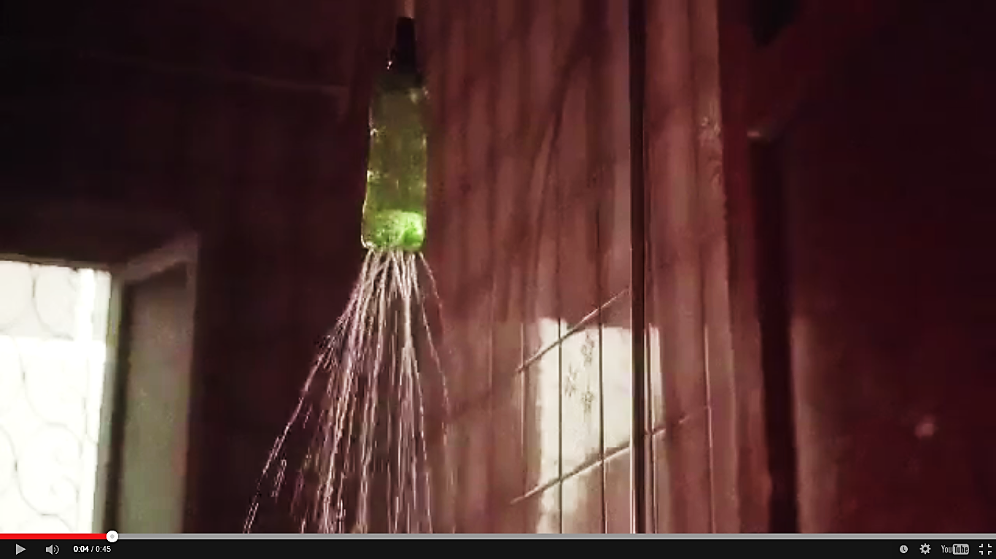

Slide 21
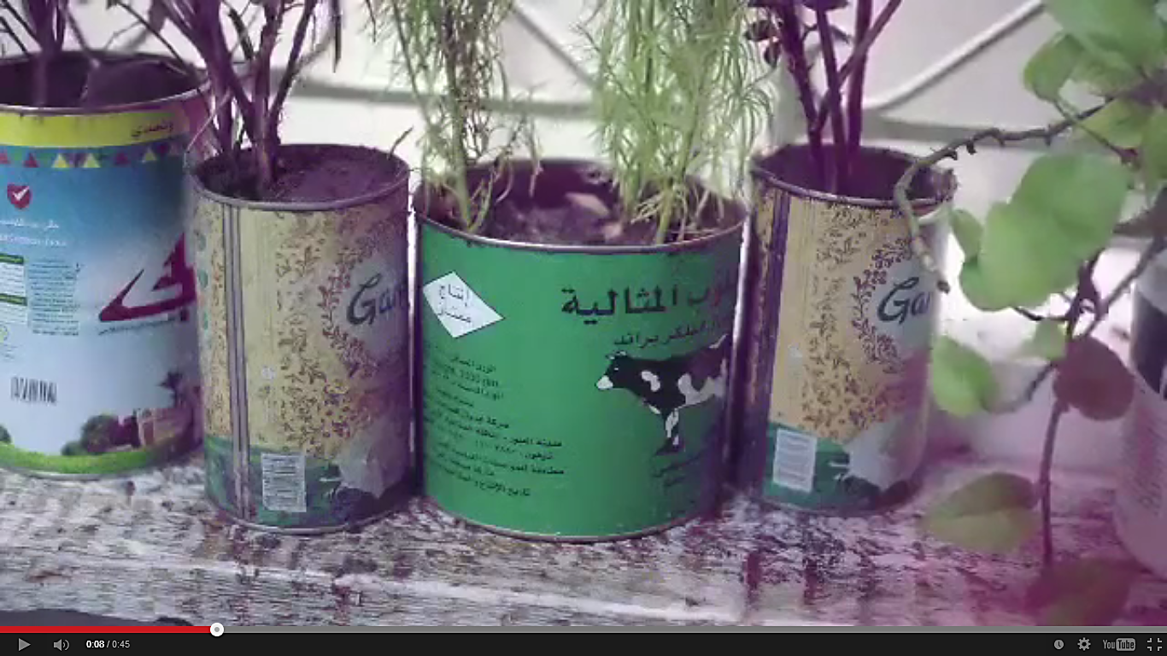

Slide 22


Slide 23


Slide 24
Crowsourcing Innovation?
Innovators
need more than just funding!
Industry
needs more than just new ideas!
MKTG
Min.Risk
Quick
Feedback
Problems
Visibility
PR
Product Designs
External
Skills
Min. Risk
Low Cost (+Fund?)
Proven Solutions
Trust

Slide 25
Crowsourcing Innovation?
Innovators
need more than just funding!
Industry
needs more than just new ideas!
Product Designs
External
Skills
Min. Risk
Low Cost (+Fund?)
Proven Solutions
Trust
MKTG
Min.Risk
Quick
Feedback
Problems
Visibility
PR
OPEN-INNOVATION

Slide 26
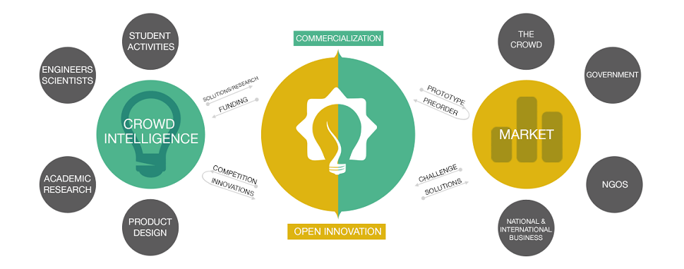
Crowdsourcing Innovation
Our Business Model
v
v
v
v
v
v

Slide 27
Crowdsourcing Innovation
Our Business Model
v
v
v

Slide 28
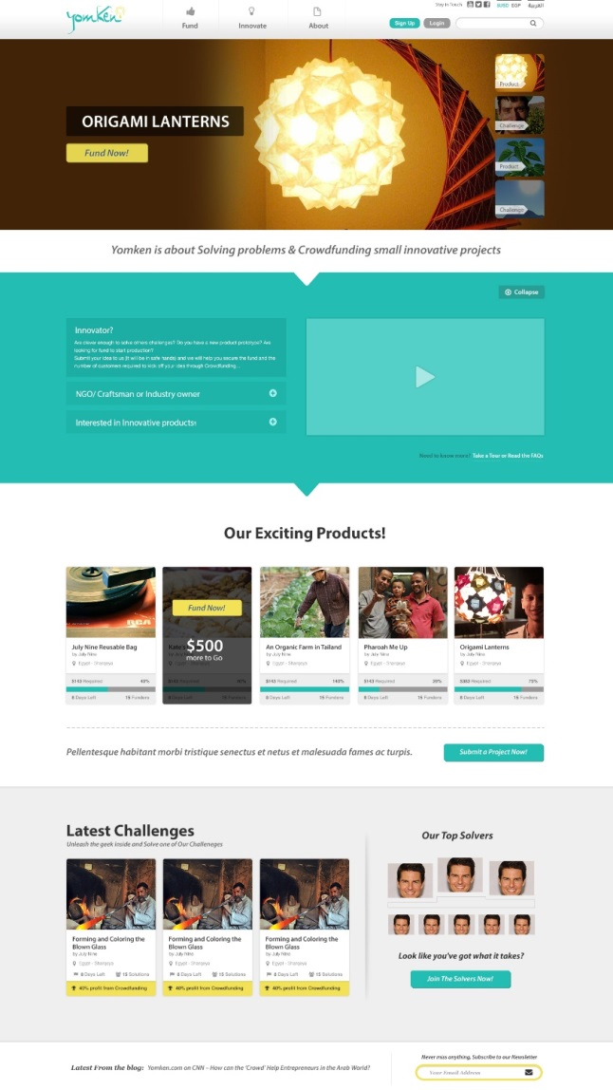

Yomken is the first social open-innovation platform of its kind, provided by
Istebdaa’, LLC. –a Cairo-based social enterprise.
Our Vision
Transforming fahlawa —which is an untranslatable Arabic word that combines wit with innovation, intuition, resourcefulness, and experience— into an economic value added.
Foundation
Yomken.com was established by Istebdaa’s in 2012. Yomken is the only platform in the MENA region that is specialized in crowdsourcing ideas and solutions for the industrial challenges faced by corporate, governmental and social organizations using its “Open-Innovation” model.
Budget
Strategic Partner
~100,000 EUR Annually (including rewards)
Team of 4 FTE + 3 interns/part-time

Slide 29
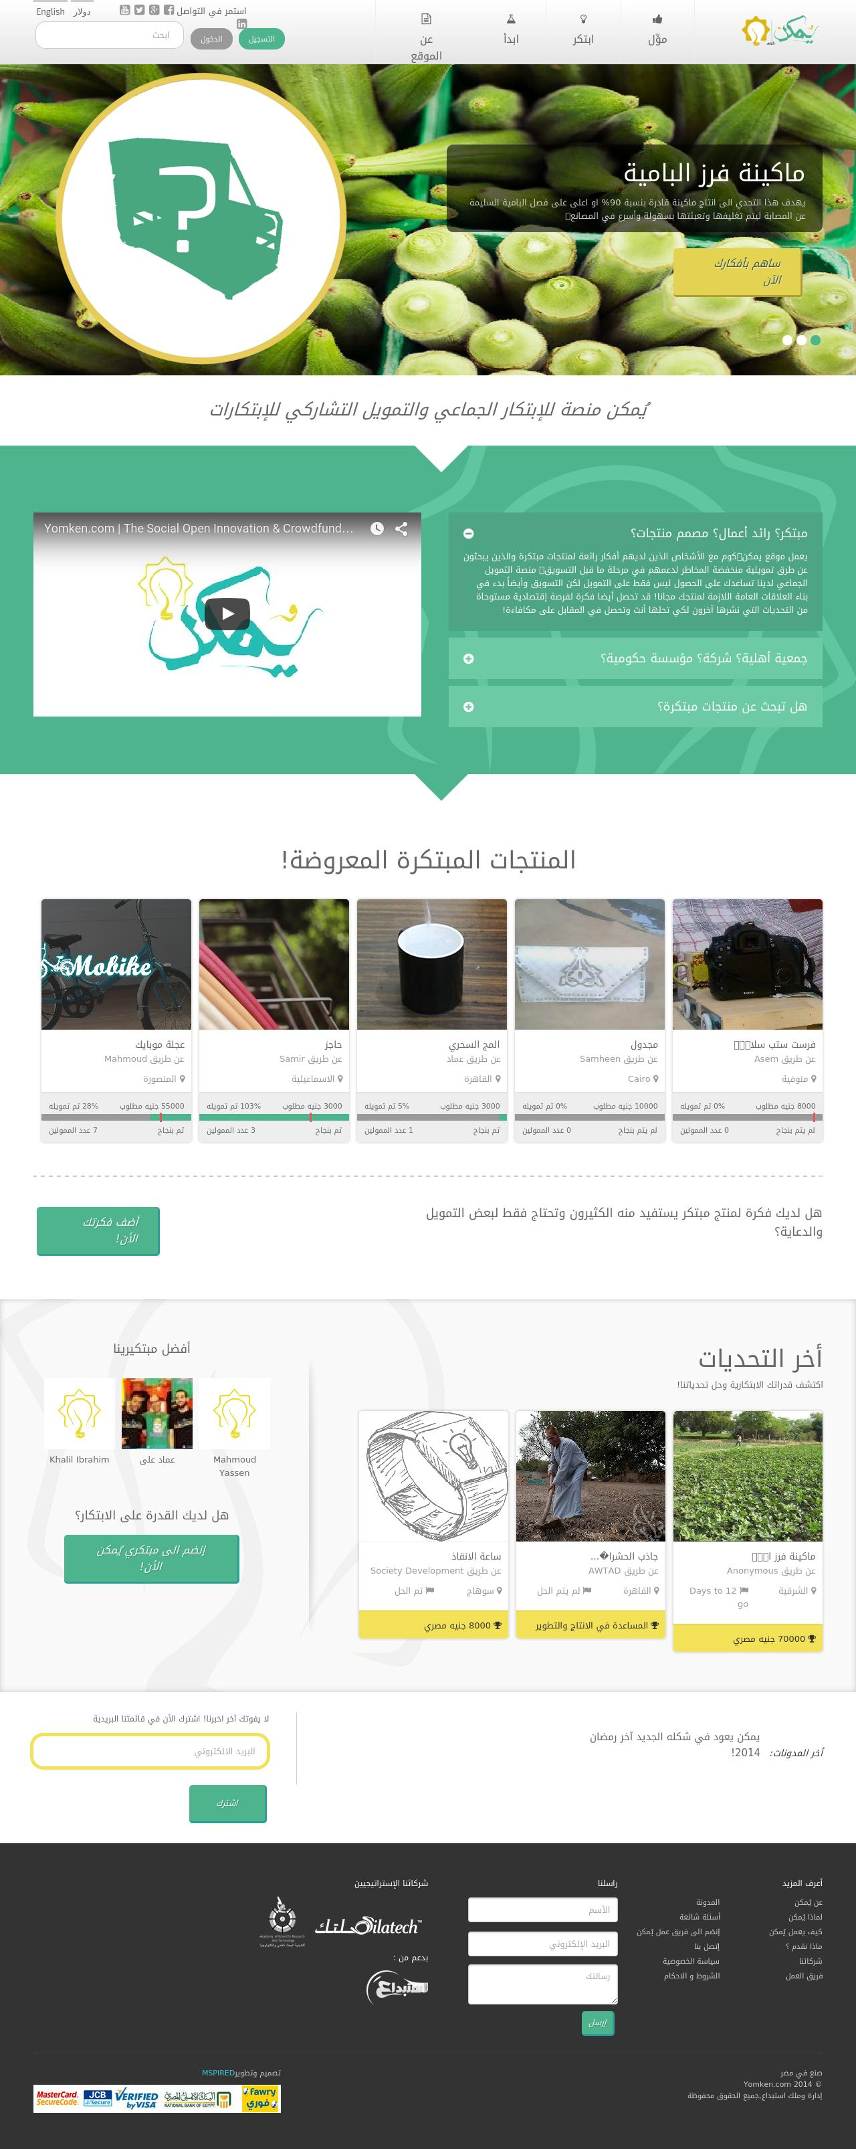

Slide 30
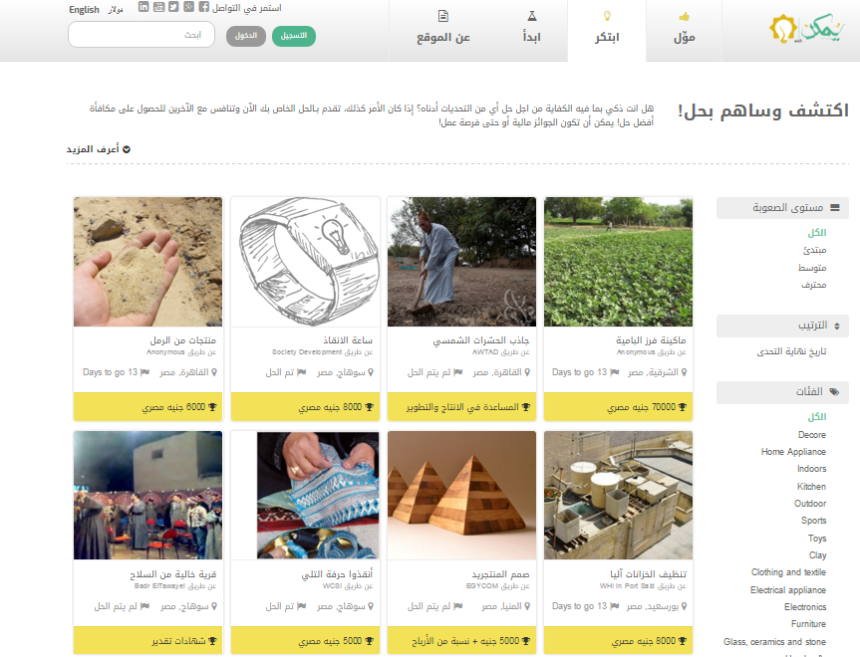

Slide 31




Types of Challenges on Yomken
1000-5000 EGP
Concept
5000-10000 EGP
Theory
10000-70000 EGP
Prototype
Varies
eRFP

Slide 32








Open Innovation provides your organization with a cost-efficient and results-proven solutions for any R&D, CSR, Marketing and/or Community Development strategies.
Reduced cost of innovation, leverage underutilized talent sources, afford multiple disjoint teams, and attempt more at the same cost.
No financial hustle, with only one check, you will get plenty of solutions, ideas and also marketing in the lowest possible cost!
Enhance the brand value, innovation the value of the brand has strong correlation. and
Increase productivity of your core team, de-centralize the innovation efforts, free up your team to oversee & foresight further innovations
Reduce the risk of not reaching out to the idea sources, be it across the wall or out of Egypt.
Eliminate chances of money drain on what does not meet your expectations, reward only a positive outcome.
With limited budget
One Single Point of Contact

Slide 33
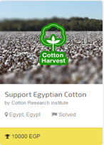
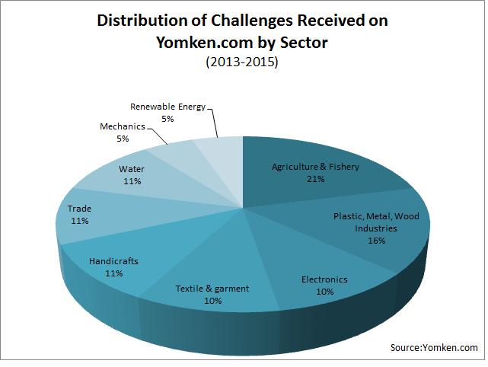
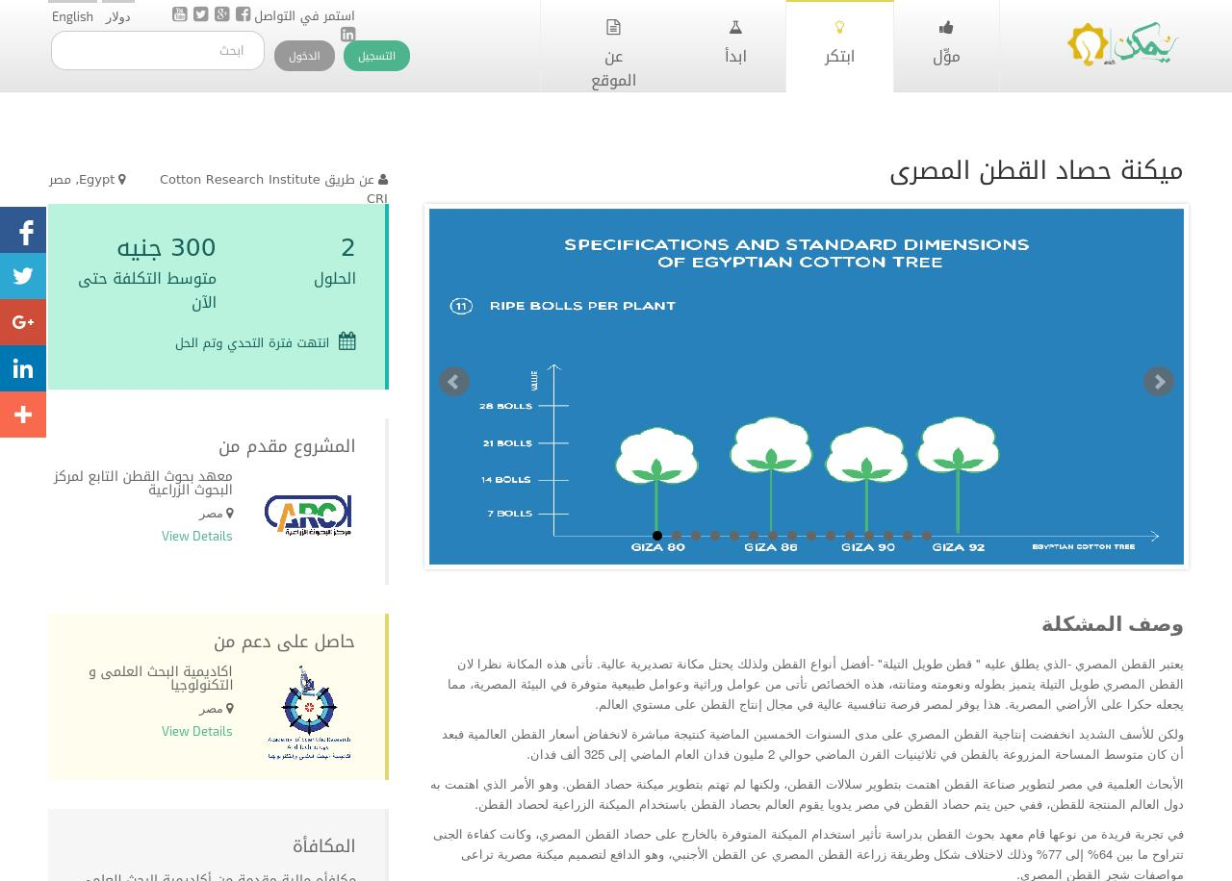
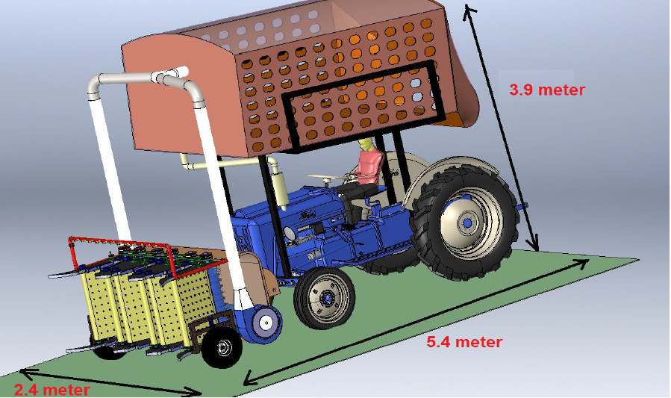
Experience: Our previous challenges range from heavy industries to handicrafts, providing multi-sectoral experience and better outreach to the team and more diverse network
Examples of Solved challenges:

Slide 34
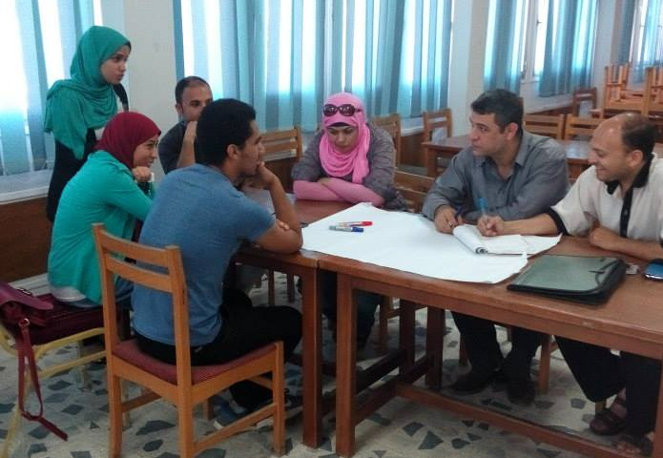
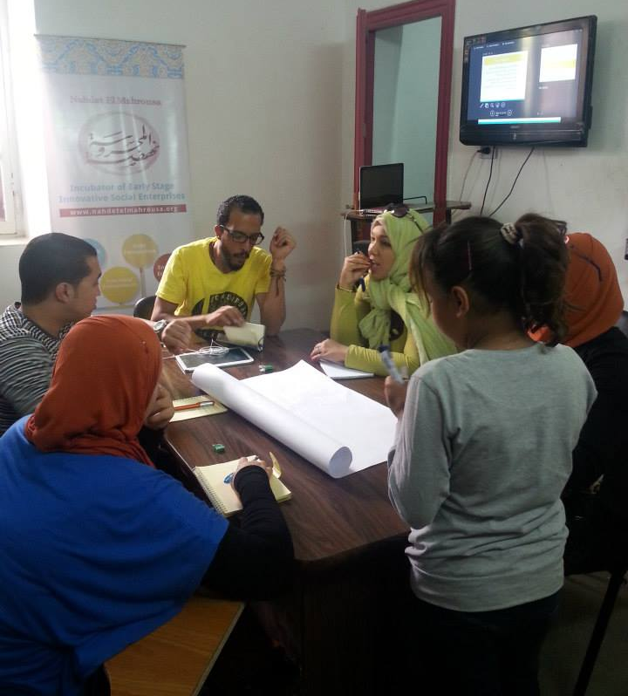
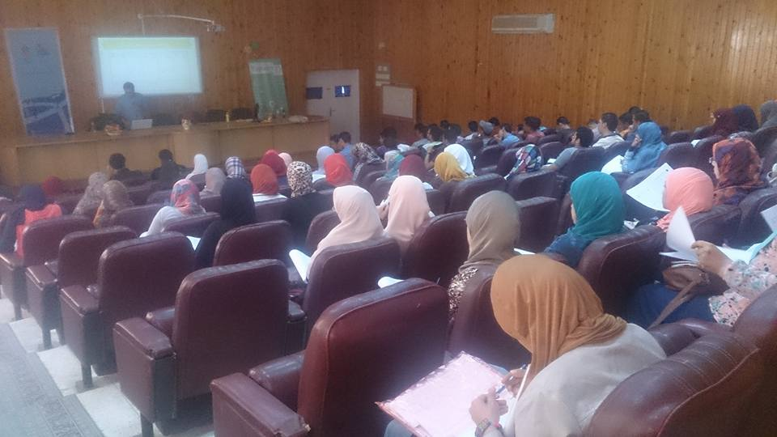
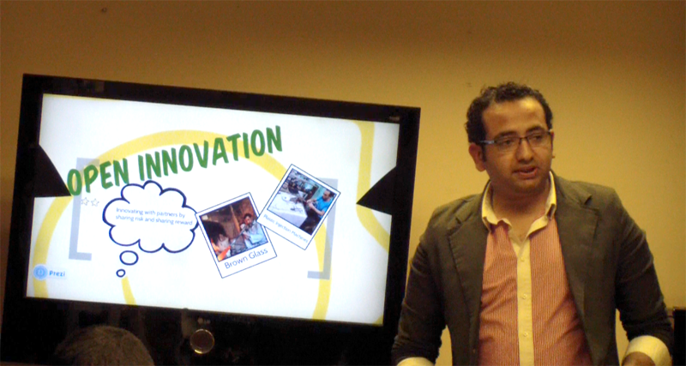

Slide 35
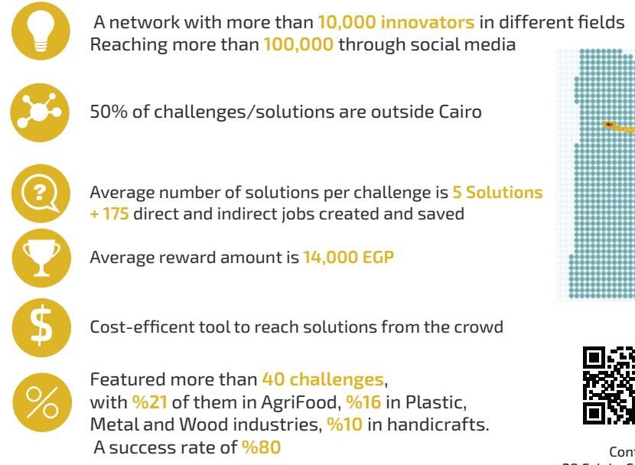

Results so far
Source: Yomken Team analysis, 2015

Slide 36
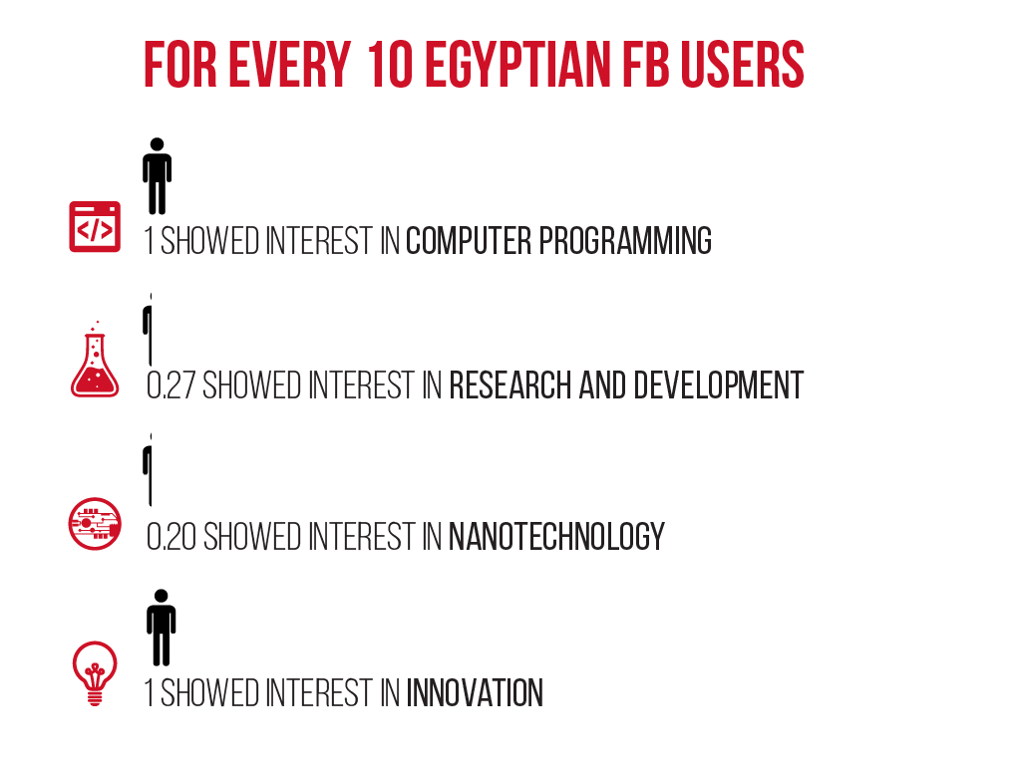
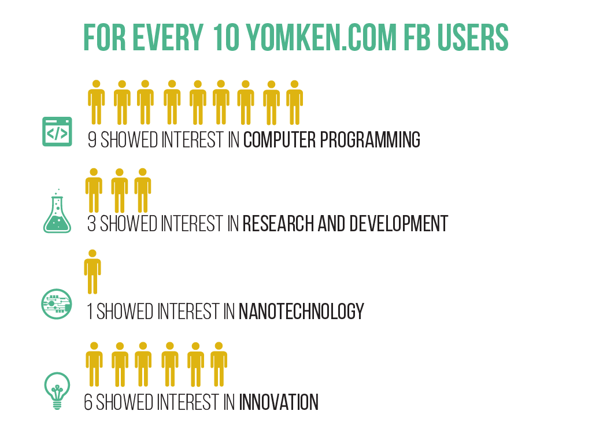
Network: Yomken’s followers are the type of solvers you are looking for: with passion and interest in innovation, scientific research and development.
Source: Yomken Team based on facebook.com analysis

Slide 37
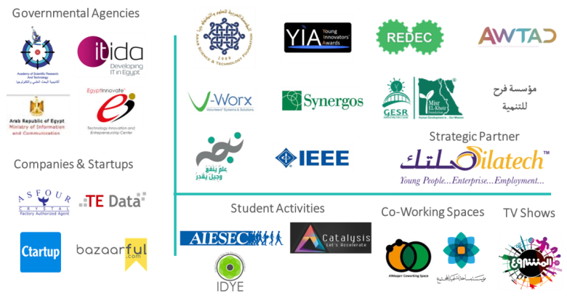







+150 Partners in Success

Slide 38
Thank You
Tamer Taha
ttaha@yomken.com
fb.com/yomkencom
Twitter.com/yomkencom
Linkedin.com/company/yomkencom

