Slide 1


Jordan Technology Transfer Network
a cost-effective model for the establishment of a national tech transfer program in the south med.
Dr Mohammed Aljafari, Managing Director of the IP Commercialization Office
m.aljafari@iPARK.jo

Slide 2
Contets
1. Context Notes
2. iPARK Introduction
3. IPCO History & Services
5. Jordan Technology Transfer Network
6. Concluding Remarks

Slide 3
1. Context Note
Open Innovation

Slide 4

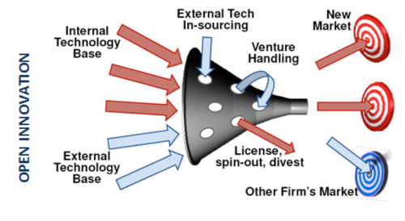
Open Innovation
H. Chesborough
Global R&D, Open Funnel
Quality over quantity, small-time innovators can plug-in

Slide 5
2. iPARK Introduction
Enabling Entrepreneurship and Innovation since 2003

Slide 6

The Royal Scientific Society
Established in 1970, the largest applied research institution, consultancy, and technical support service provider in Jordan
Established Jordan’s first TTU: In order to realize its vision, goals and policies especially those related to the economic development in Jordan

Slide 7
At iPARK We
Train
Support
Encourage
Enable
Ground
Mentor
Care for
Guide
Develop
Nurture
Protect
Back
Teach
Maintain
Appreciate
Innovators
Entrepreneurs
Aid
Focus on JOB CREATION & deliver ECONOMY EVOLUTION

Slide 8
iPARK Operations
iPARK Operations
Innovation Support: Innovation related advisory services
Entrepreneurship Support: Incubator and incubation operations management

Slide 9
Since 2003,
more than:
75
1300
85%
Companies incubated
Jobs created
Export products & services
$1.2 M
12k
3.5k
First round investments for local and regional deals
People participated in awareness and networking activities
Received in Training
20⁺
500⁺
IP Policies Drafted and enacted
IP Assets Handeled
If iPARK were a company, it would have been among the largest 10 companies in Jordan

Slide 10
3. IPCO History & Services
Jordan’s First Technology Transfer Office
Serving Innovators and Innovation Institutions

Slide 11
IPCO Development
2006 :Technology Transfer Center (TTC) of the Royal Scientific Society
In order to realize its vision, goals and policies especially those related to the economic development in Jordan. IPCO served internal clients.
2010: TTC added commercialization and became IPCO
IPCO started providing IP services to other institutions
2014: IPCO redeveloped its offering as a value centric service
IPCO enables the creation and capture of value from innovation

Slide 12
IPCO Tech/Value Approach
Environment
Technology
Helping Innovators Gain
Readiness

Slide 13
IPCO Services
Technology
Tech Review & Evaluation
Partnership mapping
Business Development
Business Planning
Financial Modeling
Institutional
Governance
Innovation Mapping
Outreach
Tech Transfer Support
National
Jordanian TT Network
Participate in strategy setting
Participate in IP law discussions
Multinational Initiatives and Partnerships
Deal Structuring
Deal Based
Valuation
IP Related
Strategy
Operational Model
IP/Innovation policy updating

Slide 14
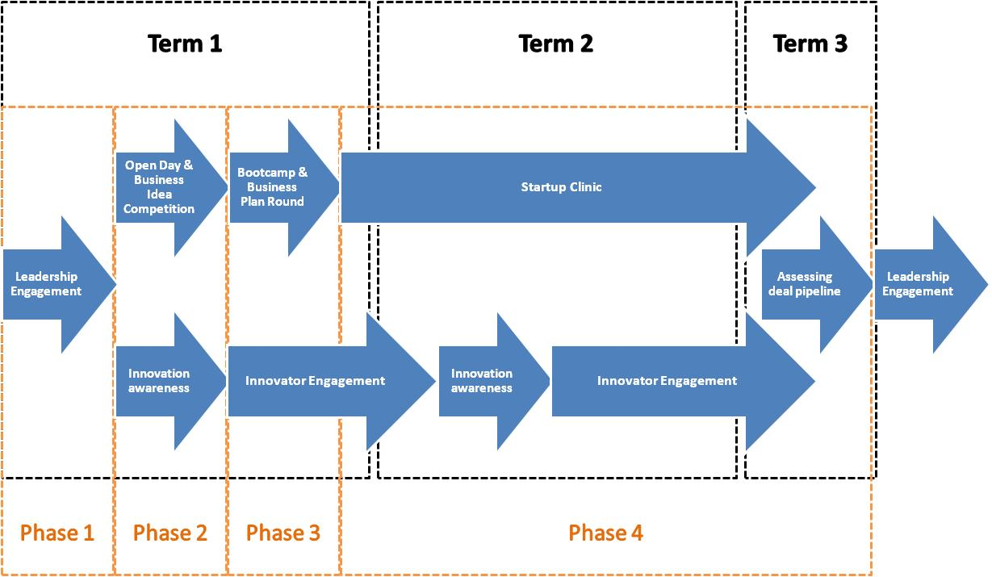
Example of an Institutional Service: Innovation/Entrepreneurship Enablement

Slide 15
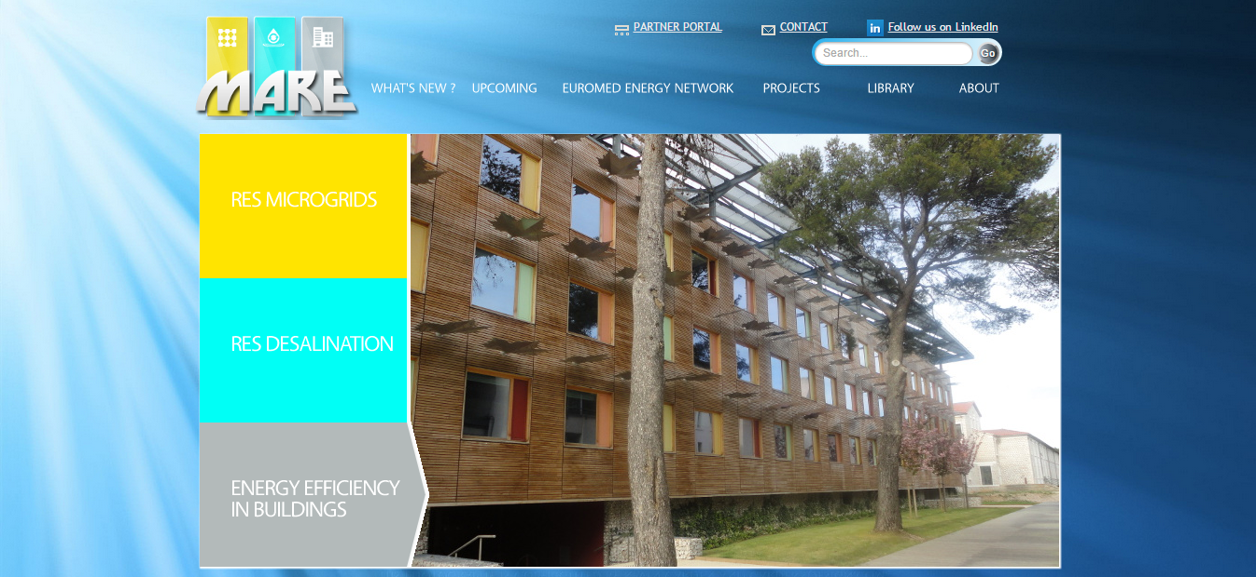



Slide 16
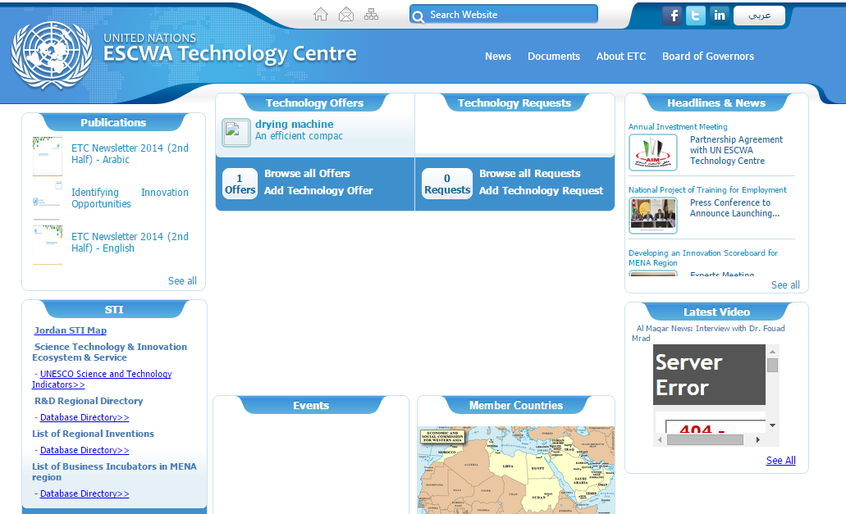

Slide 17
4. The National Technology Transfer Network
A National Platform

Slide 18

Jordan Technology-Transfer Network JTN
Established 2010
Lead/managed/coordinatd by IPCO
Establish Tech Transfer Units (TTU) at participating institutions
IPCO provides ongoing TT & Commercialization

Slide 19
~20 Members
Jordan University of Science and Technology
University of Jordan
Jerash Private University
Philadelphia University
Petra University
Amman Chamber of Industry
Jordan Industrial Estates Company (JIEC)
Jordan Enterprise Development Corporation (JEDCO)
Al Urdonia Lil Ebda
Mutah University
Yarmouk University
King Abdullah II Design and Development Bureau (KADDB)
King Abdullah II Fund for Development (KAFD)
Applied Scientific Research Fund (ASRF), MonoJo
Hashemite University
Al Balqa' Applied University
Princess sumaya University for Technology
National Center for Agricultural Research and Extension (NCARE)
German Jordanian University (P)
IPCO

Slide 20
JTN Network Design
IPCO
Universities
Industrial Estates
Research Centers
Incubators
Industry Associations
Not enough demand to justify replicating IPCO in each institution
Better efficiency from a “hub and spoke” network approach

Slide 21
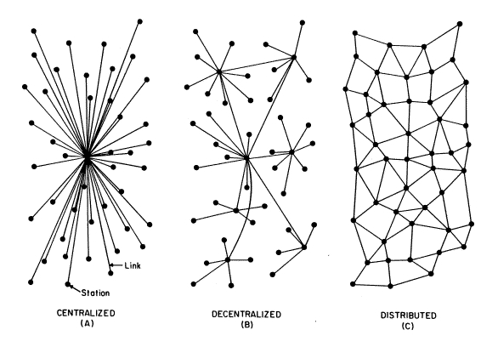
Centralized Network for Efficiency

Slide 22
Operational Considerations
Every member assigns a TTU and a technology transfer officer (TTO)
Supported by SRTD, each TTO received training
New members receive an entry package from IPCO (awareness, engagement, policy and training)

Slide 23
Operational Considerations Cont.
The network is currently only directly supported by IPCO, SRTDII is supporting specific offices
The network generates no revenue
Revenue is generated from services provided to members

Slide 24
Network Sustainability
Convenience
Value Perception

Slide 25
Build more/stronger linkages and introduce robustness

Slide 26
5. Concluding Remarks
Unhealthy Obsessions

Slide 27
Unhealthy Obsessions
Absorptive Capacity of Industry
Local IP Laws
Investment Intensive Initiatives
Cost of Route to Market
Knowledge/Green/Space Economy
Public Sector Intra-Funding
Strategy
Protect IP
Knowledge: Industry Input-Output
Fit-for-purpose laws/ leverage “islands”
Strategy: measure & report
Partnership Strategy
Economic Agility/ Gov. Entrepreneurship
Burn Public Cash
Governance
Invest in IP

Slide 28
Thank You

