Slide 1
Private sector growth and cronyism in Egypt
Ishac Diwan
(with Phil Keefer and Marc Schiffbauer)
Oct 2015

Slide 2
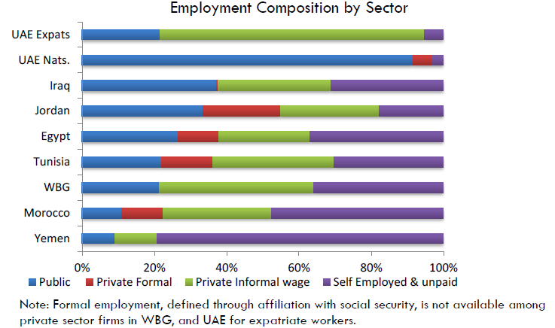
The formal private sector never grew employment by sector

Slide 3
Private investment low in Egypt

Slide 4
Low labor productivity growth (in industry)

Slide 5
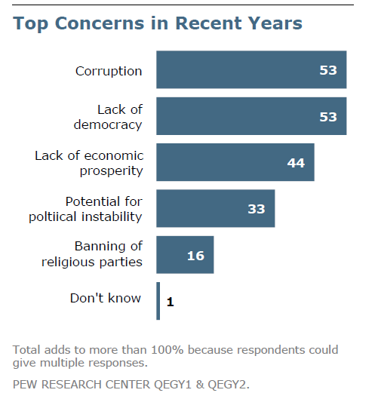
High levels of perceived corruption in business and government
Gallup 2009-11
PEW, 2011

Slide 6
What is wrong with “crony” capitalism?
Much talks about cronyism and corruption – but much less quantitative work on the magnitude of the effect on growth.
Egypt a great laboratory
State-led development under Nasser, timid opening to the private sector by Sadat – constitution of a business elite – marriage of state bourgeoisie and old money
After 2004, “take-over” of the formal economy by new business insiders closely connected to the ruling party
Can help given predatory public sector – corruption as oil in the wheels
But can also discourage investments (sand in the wheels)
Empirical work needed to understand sign and magnitude of effect on economy
Hypotheses about economic impact of preferential treatment
Do sectors with CFs grow less than “unconnected” sectors?
Document mechanisms of exclusion leading non-connected foirms to take a back seat and reduce job gowth

Slide 7
plan
Identifying the top-tier Politically Connected firms (PCFs) in Egypt
Privileges
Impact on the growth of non-connected firms
Policy implications
Builds on several literatures
Corporate:
pyramidal structures: Wolfenzon
Value of connections: Faccio , Fisman
Economy-wide effects:
Competition and entry (Aghion)
Political economy:
gift exchange (Vishny/Shleifer);
Rules vs deals (Pritchett,Werker)
Industrial Policy: Khan for, Aedes and di Tella against.
Middle East
Owen, Henry and Springborg, Luciani, Heydeman, King..

Slide 8
I. Who are they? What privileges?

Slide 9
Data
We construct a dataset of politically connected (PC) firms under the Mubarak regime in Egypt.
The information is combined with 3 additional sources on firm level data:
Orbis database: provides firm level information of PC and other large firms; panel of about 20,000 larger firms from 2003-2011.
Establishment census: provides information on employment and firm characteristics of all economic establishments (2.4 million) in 1996 and 2006; merged with list of PC firms at (ISIC Rev. 4) 4-digit sector level (372 sectors).
World Bank Enterprise surveys: provides firm level information on perceived policies; we pool various surveys between 2004 and 2008 (>4,200 firms in total); merged with list of PC firms at (ISIC Rev. 3.1) 4-digit sector level (90 sectors).
In addition, we use data on non-tariff barriers to trade (NTMs) from the World Bank (WITS) and energy intensities of manufacturing industries from the UN.

Slide 10
Identification of PC firms
Identified 32 politically connected businessmen who served in boards of 4 think tanks founded by Gamal Mubarak.
Many of them had significant political posts
assets of most frozen after the Egyptian uprisings of 2011
Identify 104 publicly listed firms in which they served as CEOs, board members, or major shareholders (>10%).
Several of the 104 firms are holding companies or investment funds masking large business conglomerates.
Recovering all subsidiaries (up to two tiers), we identify 469 firms that are directly or indirectly controlled by one of the PC businessmen.
Notes:
These include the following institutions: The Egyptian center for economic studies, The American Egyptian Works Council, The Policies Committee, and the Future Generation Foundation.

Slide 11
What do PCFs look like?
PC firms are present in about ½ of the sectors:
Overall: in 186 of 372 (49%) 4-digit ISIC Rev. 4 sectors.
Manufacturing: in 73 of 126 (58%) 4-digit sectors.
Larger, higher debt, more capital intensive
High concentration in new sectors: tourism, real estate, construction, wholesale & retail trade, mining, finance, business services, and some manufacturing sectors.
Vertical and pyramidal structures common

Slide 12
ii. The nature of privileges

Slide 13
What’s the value of connections? Stock market prices of CFs drop by 23.4% more than NCFs in early 2011
Chekir and Diwan, 2015, forthcoming, JGD

Slide 14
PCFs in manufacturing are more likely to be protected from import competition
Average (weighted) tariffs and NTMs on imports
Most NTMs in Egypt in form of legal technical barriers to import including licenses requirements, regulations on distribution, or product-quality & inspections related to rules of origin.
Source: WITS
The more technical barriers to import, the more industry dominated by PC firms: 71% of PC firms are protected by at least 3 NTMs (class B) relative to 3% for all Orbis firms.
Notes:
NTMs appear to protect more concentrated industries since 65% of all industries had some NTM protection but only 56% of all firms.

Slide 15
Among large firms firms PC firms disproportionally benefitted from energy subsidies 45% of politically connected firms operate in energy-intensive industries compared to only 8% percent of all manufacturing firms.
Firms in energy intensive sectors disproportionally benefit from subsidized energy prices
Subsidies to energy intensive sectors accounted for 24.9% of total energy subsidies, which were about 11.6% of GDP in 2010 -- a total of about 2.9% GDP or USD 7.4 billion.
In comparison, public investment was 6.2% GDP in 2010.

Slide 16
Access to capital
PC firms borrowed much mote -- 82% of loans going to private sector.
Why would private banks lend to CFs?
These firms are more profitable
implicit bail out guarantees - PER much higher than NCFs
Some banks controlled by connected interests, and/or by the state

Slide 17
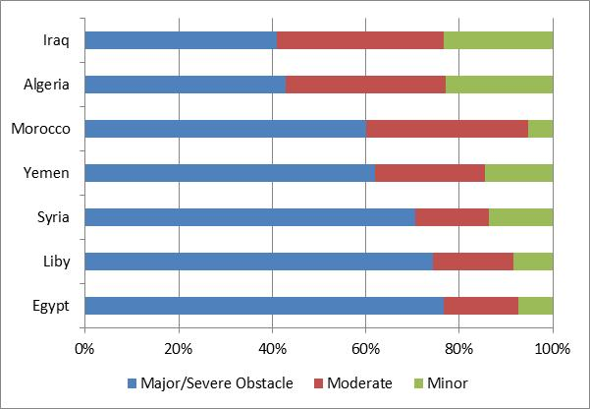
Discriminatory policy implementation creates an uneven playing field.
Regulatory policy uncertainty as an obstacle to firms’ growth
Notes:
Fourth, discriminatory policy implementation in the Middle East and North Africa crates an uneven level playing field reducing competition among firms.
[For instance, we find that firms with deep political connections in Egypt receive fewer tax inspections by government officials while the majority of firms without such connections are inspected frequently.]

Slide 18
Connected sectors (CEO) get permits faster, but wt more variability
 | Waiting days for Construction Permit | CoV (Construction Permit)
PC sectors | -48.1** | .192**
No. of firms /Sectors | 1066 | 63
R-squared | 0.070 | 0.468
Source: World Bank Enterprise Surveys for Egypt. We merged various surveys between 2004 and 2008 (>4,200 firms in total); merged with list of PC firms at (ISIC Rev. 3.1) 4-digit sector level (90 sectors).
.

Slide 19
Iii. Does the presence of connections suppress growth opportunities of non Connected firms?
What about the “others”?

Slide 20
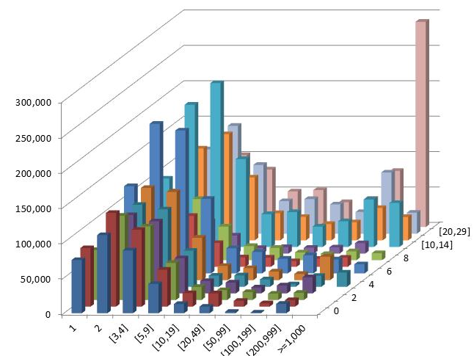
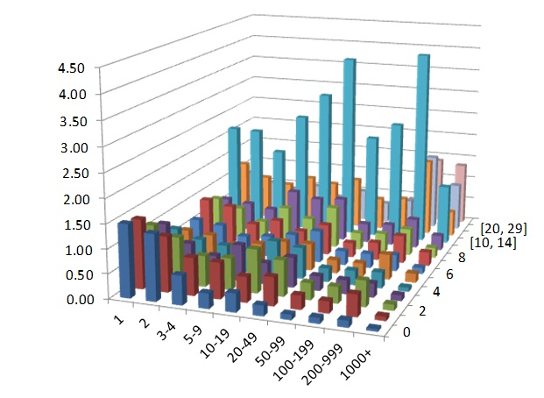
The missing middle: connected to cronyism?
Lack of growing SMEs with potential to challenge large firms in Egypt
This can reduce growth if it reduces sector level investment and innovation
Egypt
Turkey
Missing Middle

Slide 21
Empirical strategy
Compare firm dynamics across sectors, which differ in their intensity of Political connections.
Firm dynamics and employment growth based on establishment census data in 1996-2006 (which we aggregate to the 4-digit sector level).
Census covers over 2.4 million establishments
Merged data has 355 non-government 4-digit sectors, of which 174 have PC firms
Notes:
We exclude the following sectors as firm dynamics in these sectors are driven by the government and not private sector dynamics in Egypt: public administration, education, health, arts, and household service activities are excluded (ISIC codes >8400).

Slide 22
The model
∆Y (s,2006-1996) = A PCEntry (s,1997-2006) +
B NPC (s,1996) +
C [PCEntry(s,1997-2006)* NPC(s,1996) +
βX X (s,1996) + S + ε (s,2006)
∆Y(s,t) = employment growth of the (4-digit) sector s between 1996 and 2006,
PCEntry is the entry of politically connected firms in sector s between 1997 and 2007,
NPC are sectors without crony firms before 1997,
X is a matrix of control variables (employment and age),
S a matrix of sector dummies

Slide 23
Direct evidence: Employment growth declines after politically connected firms enter initially unconnected sectors (census data)
 | Employment growth 1996-2006
Entry PC | 32.2* | 36.1**
Not connected before 1996 |  | -6.32
Entry PC * not connected before 1996 |  | -24.8**
No. of sectors | 224 | 224
R-squared | 0.161 | 0.163
Source: Establishment census data all non-agriculture, non-government sectors in 1996 and 2006 and sample of politically connected firms. Note: PC indicates the number of politically connected firms varying at the 4-digit sector level. The number of employees (size) and firm age vary at the firm level. All firm level regressions include 1-digit sector dummies. Standard errors are clustered at the sector level. *, ** denote significance at the 10%, 5% significance level, respectively, t-statistics are reported in parentheses.

Slide 24
What kind of bias? Do PCF enter dying sectors or growth sectors? Entry of politically connected firms into initially unconnected sectors. 1997- 2006 (4 digit sectors)
Quarrying of stone, sand & clay Distilling, rectifying, blending of spirits
Manufacture of soft drinks & mineral water Manufacture of fertilizers
Manufacture of basic precious metals Manufacture of primary cells & batteries
Manufacture of television & radio receivers Manufacture of jewelry & related articles
Recycling of metal waste and scrap Recycling of non-metal waste and scrap
Electricity production, transmission & distribution Manufacture & distribution of gas
Collection, purification & distribution of water Wholesale of textiles, clothing & footwear
Wholesale of solid, liquid & gaseous fuels Electronic & telecommunications parts
Retail sale in non-specialized stores with food Inland water transport
Life insurance Renting of land transport equipment
Legal activities Advertising
Sewage & refuse disposal, sanitation Motion picture and video production
Dramatic arts, music & other arts activities

Slide 25
Average annual value added growth rates (in percentage) of treatment and control group manufacturing sectors in all other countries between 1996 and 2006
 | All | HICs | LDCs | MENA | ECA | LAC
Unconnected sectors in 1996 subsequently entered by crony firms in Egypt | 2.28 | 1.50 | 3.08 | 2.67 | 4.94 | 1.94
Unconnected sectors in 1996 that remained unconnected in Egypt | 1.12 | 0.77 | 1.47 | 0.46 | 2.66 | -1.61
Difference | 1.16** | 0.73** | 1.61* | 2.21 | 2.28** | 3.55
Source: UNIDO (INSTAT4) and sample of politically connected firms in Egypt. “All Countries” includes all 104 countries with available data (excluding Egypt), “All Developing” 76 developing countries (excluding Egypt), “High Income” 28 high income countries, “MENA” all developing countries in the Middle East and North Africa, “ECA” all countries in Eastern Europe and Central Asia, “LAC” all countries in Latin America and the Caribbean (excluding small island states).
*, ** denote that the difference in annual growth rates between the treat and control group sectors is significance at the 10%, 5% significance level (after controlling for 1-digit sector dummies).

Slide 26
Average annual growth rates (in percentage) of treatment and control group manufacturing and service sectors in Jordan between 1996 and 2006
 | VA | Log(Inv) | Wages | Profits
Unconnected sectors in 1996 subsequently entered by crony firms in Egypt | 0.79 | 6.94 | 0.79 | 1.49
Unconnected sectors in 1996 that remained unconnected in Egypt | 1.17 | 5.44 | 0.85 | 1.56
Difference | -0.38 | 1.50** | -0.06 | -0.07
Source: Department of Statistics Jordan and sample of politically connected firms in Egypt. Note. We observe 13 new manufacturing and non-government service sectors entered by crony firms after 1996 and 44 sectors that remained unconnected.
*, ** denote that the difference in annual growth rates between the treat and control group sectors is significance at the 10%, 5% significance level (after controlling for 1-digit sector dummies).

Slide 27
Mechanism
Aghion, et al. (2001). In sectors dominated by firms with large and exclusive cost advantages, firm size distribution should exhibit a large market leader and a potentially large number of small firms using vintage technologies of low efficiency to serve local market niches.

Slide 28
Employment distribution before and after the entry of crony firms into previously unconnected sectors
Source: Establishment census data including over 2 million firms in all non-agriculture, non-government sectors in 1996 and 2006 and sample of politically connected firms.

Slide 29
Summary of results
We have found that:
a small number of entrepreneurs have managed to control a rising and substantial share of the Egyptian formal private sector over time
The PC firms tend to operate behind trade barriers, benefit disproportionately from energy subsidies, and from regulatory favors
There is less entry and job creation in the sectors in which they operate
These effects add up to a sizable negative aggregate impact on growth
If connections are eliminated in industry, entry would rise, generating on extra 25% jobs in these industries

Slide 30
How to improve private sector dynamism?
Economic reforms will be central to support the evolution of a more competitive form of capitalism that can elicit innovation. Initiatives can include:
Competition policy
Democratizing credit
Judicial reforms
Laws on conflict of interest
Freedom of information acts
Government capacity to regulate the private sector
How to initiate change in a politically feasible way? Constituencies that can be mobilized :
Business associations (Turkey)
Financial inclusion initiatives (Morocco)
Labor unions (Tunisia)
Consumers (Lebanon)

Slide 31
Extra slides

Slide 32
PC firms had larger net profits than other firms. In 2010, they accounted only for 11% of employment and 60% of net corporate profits -- but profits plummet after the fall of Mubarak

Slide 33
Egyptian capitalism in the 2000s
Slow economic but not political liberalization under Mubarak1:
Strategic sectors opened up (telecom, steel, construction, cement, …)
Credit boom in the 1990s: state banks (39 of them!) lend to a “connected business elite” leading to high NPLs (24%) by 2003.
Gamal Mubarak era (2004-2010)– Business elites enlarged, take top political jobs
Macro stabilization, economic reforms (trade, finance, privatizations)
Recapitalization and privatizations of banks (15 banks wt foreign ownership)
Main question: reforms great on paper -- but why is the supply response timid and growth performance moderate?
Rise of non-tariff barriers, high concentration in bank lending , energy subsidies to industry
Private investment and formal private sector remain small, capital flight high

Slide 34
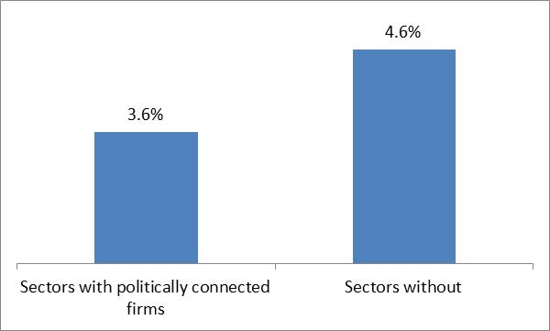
we observe weaker firm dynamics in industries dominated by politically connected firms -> Privileges suppress the firm dynamics associated with job creation
Analysis based on the establishment census suggests that sectors with a larger concentration of CFs tend to show lower dynamism
Firm distribution more skewed towards small scale and informality.
Lower firm entry rates
Lower firm growth; i.e. small firms stay small over time.
WBES: Less competition reported in sector dominated by connections
Firm startup is lower in sectors dominated by politically connected firms
Job growth in a sector is about 1.4%-points lower (annually) when connected firms exist in the sector.
Notes:
We exclude the following sectors as firm dynamics in these sectors are driven by the government and not private sector dynamics in Egypt: public administration, education, health, arts, and household service activities are excluded (ISIC codes >8400).

