Slide 1
Migration and Refugees’ Crisis in the EU – Med: Dawn of an Era of shared responsibility? Plenary I: “Impact of the Refugees’ Crisis on Neighboring Southern countries” The Tragedy And Hope of Syrian Economy: Between Two Plans! مأساة وأمل الاقتصاد السوري بين خطتين!
Dr. Osama Kadi;
President of Syrian Economic Task Force SETF
Casablanca –Morocco
29th – 30th April, 2017

Slide 2
Syrian Economy: before Revolution/March 2011
In the early 2000s, Syria embarked on a gradual economic liberalization (by few oligopolistic called holding companies) to spur growth.
Structural reforms were aimed at deregulating and diversifying the tightly-managed, state-focused economy, while phasing out energy subsidies and streamlining the tax regime.
In 2004, private banks were allowed to begin operating.
In 2009 the stock market re-opened after more than 40 years.
Syria requested to become a member of the WTO in 2001.
Signed a free trade agreement with Turkey in 2007.
Inflation was low and growth robust (non-oil growth averaged 4.4 percent during 2000–09).
The public sector remained dominant, fiscal deficits were manageable with public debt standing at 31 percent of GDP at the end of 2009*.
* All info above according to IMF working paper - WP/16/123 -Syria’s Conflict Economy , Jeanne Gobat and Kristina Kostial, June 2016.

Slide 3
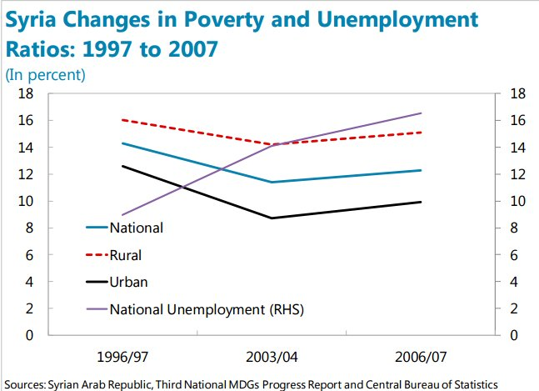
Syrian Economy: before Revolution/March 2011
Poverty and unemployment were on the rise in the second half of the 2000s.
Unemployment almost doubled within a decade to more than 16 % in 2006/07
The unemployment rate was highest among the youth (age 15–24) @ 22% in 2006/07
According to Agency of Combating Unemployment 2004-2005 reached app. 20 percent

Slide 4
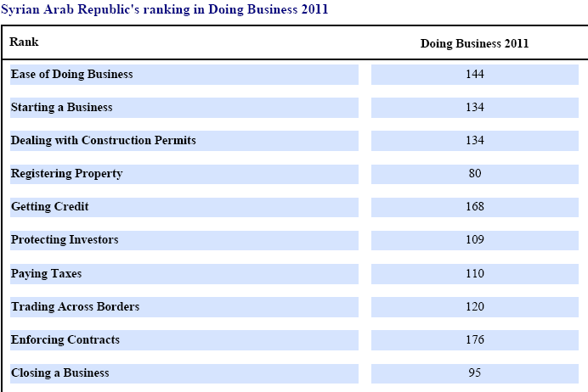
Syrian Economy: before Revolution/March 2011
Maldistribution of wealth
There were considerable regional disparities.
Rural population did not benefit from the economic liberalization reforms, and farmers in particular were affected by a multi-year drought.
The northeast region had the highest poverty ratio at about 15 percent in 2007, and accounted for more than half of the poor in Syria.
In the 2011 Doing Business Indicators, Syria ranked 144 out of 183 countries.

Slide 5
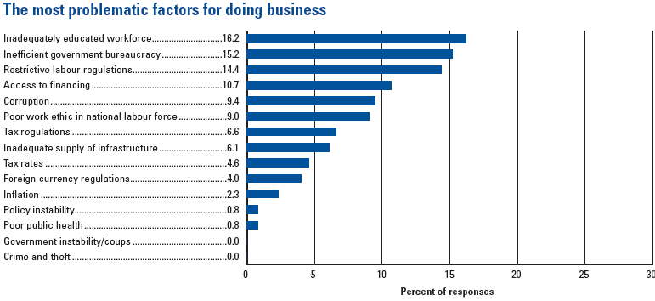
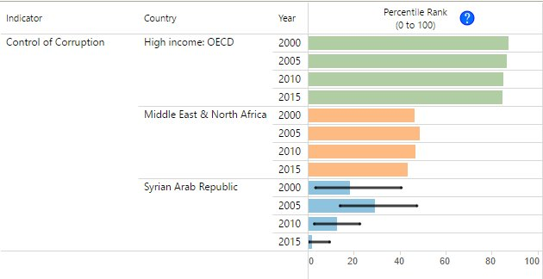
Syrian Economy: before Revolution/March 2011
Top five obstacles to firms investing in Syria included corruption, an inadequately educated workforce, and inefficient gov’t bureaucracy.
More than 80 percent of firms indicated at the time that they were expected to give gifts to public officials to “get things done,” compared to a regional average of 37 percent.
2011 Doing Business- World Bank

Slide 6
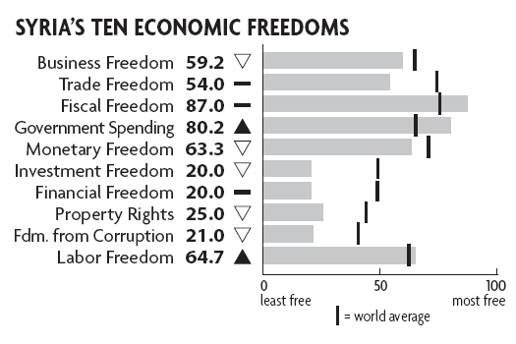
Syrian Economy: before Revolution/March 2011
Economic Freedom in 2011: 140/179 (2016: above 178) 128/141 Fraser Institute (153/157:2016) Heritage Index of Economic Freedom, Syria was ranked as “repressed” or “mostly unfree”
Syria’s government institutions lacked public accountability and were plagued by corruption, while the judiciary was viewed as neither transparent nor independent.
http://www.freetheworld.com/2015/economic-freedom-of-the-world-2015.pdf

Slide 7
Syrian Economy Tragedy 2011-2017
Seven years into the ongoing & tragic conflict
The devastating civil war has set the country back decades in terms of economic, social and human development.
The Syrian pound lost at least 85 percent (from 50 SP in 2011 to 530 in 2017 = $1
Syria’s GDP today is less than third of what it was before the war started
Economy has contracted in real terms by 57 percent since 2010.
It could take two decades or more for Syria to return to its pre-conflict GDP levels
Human capital has been torn apart: more than half of the population (+15 out of 25 Millions) killed, , jailed, disabled, displaced, or refugees.
2016, 13.5 million people in Syria are in need of humanitarian aid, including six million children.
4.6 million people are in hard-to-reach areas, including close to 500,000 people in besieged areas.
Foreign NGOs have been somewhat restricted in their assistance, as they cannot distribute aid without formal authorization by the government.
Crude oil production in areas under government control has fallen sharply, declining to about 9,000 barrels per day (b/p) in 2014 from 386,000 b/p in 2010, a 98 percent decline in oil GDP.

Slide 8
Syrian Economy Tragedy 2011-2017
* Syria is deeply fragmented.
* ISIL controls about less than third of Syria’s territory (by land mass), in particular the resource-rich north and the eastern/central part of the country.
* The Kurds hold about +15 percent of the territory (by land mass) in the northeast and a small pocket in the northwest.
* The Syrian regime controls most of the west—the coastal area and some parts of the south. These areas are more densely populated, with the west and Damascus accounting for about 55 to 70 percent of the population.
* There are also parts that are held by other anti-regime forces

Slide 9
Syrian Economy Tragedy 2011-2017
GDP was to be approximately $55 billion, and reached in 2017 less than $5 billion.
Unemployment +80 Percent (+ 4 million of labor force)
People under poverty line +85 per cent
Inflation +500 per cent, and in the besieged areas +3000 per cent
More than two-thirds of Syrians are living in extreme poverty
Loss of property, jobs, and access to public services, including health and clean water
+15 Millions displaced or killed
+2.1 million homes have been destroyed
School attendance has dropped by more than half, with more than 2 million children in Syria out of school

Slide 10
Syrian Economy Tragedy 2011-2017
one-quarter of schools are not operational, and there is a significant shortage of teachers. (UNICEF)
over 700,000 children of Syrian refugees are out of school. (UNICEF)
10 Per cent of 3.7 million Syrian children that have been born since the conflict began in 2011 are born as refugees.(UNICEF)
Life expectancy has declined by 20 years within a span of four years (to 56 years in 2014, down from 76 years in 2010)
Health clinics have been closed; health services severely curtailed; about one-fifth of all primary health care facilities are not functioning and another one-fifth are functioning at limited levels;
and half of the country’s hospitals have been destroyed.(UNDP)
The ratio of doctors to the overall population has declined to 1:4,000 in 2014,13 down from 1:661 in 2010

Slide 11
Syrian Economy Tragedy 2011-2017
Vaccination rates for children have fallen to 50–70 percent from 99–100 percent before the crisis.
Diseases that had long disappeared in Syria such as polio, measles, and typhoid have reappeared. Unsafe drinking water and poor hygiene practices are further increasing the risk of infections and illnesses among children.
Two thirds of children in Syria are without safe and reliable water.(OCHA)
Only one third of Syria’s sewage is now treated.
UNICEF estimates that more than 4 million children and women are in need of nutritional assistance.
Since mid-2014, the government has cut price subsidies on bread, rice, sugar, and water, as well as closed down government-run bakeries in opposition held areas.
The Syrian regime destroyed tens of bakeries and hospitals in the opposition areas.

Slide 12
Syrian Economy Tragedy 2011-2017
Energy infrastructure—including oil and natural gas pipelines and electricity transmission networks—has been damaged.
More than 30 of Syria’s power stations were inactive
40 percent of the country’s high voltage lines had been damaged
Wheat production dropped from 3.5 M/T to less than 2 M/T.
Olive production has declined to 400,000 tons per year in 2015 from 1 million tons per year
Livestock production has declined by 30 percent in cattle, by 40 percent in sheep and goats, and by 50 percent in poultry
Exports are very roughly estimated to have collapsed by about 70 percent to about $4 billion between 2010–15
The fiscal deficit has widened to over 20 percent of GDP in 2015 from 8 percent of GDP in 2010. While in nominal terms the budget has almost doubled from SP800 billion in 2010 to SP1.3 trillion in 2015, in real terms the 2015 budget is 40 percent lower than the budget of 2010.

Slide 13
Syrian Economy and the hope
Success in a post-conflict reconstruction depends on nearly simultaneous progress in the four “pillars” of post-conflict reconstruction: (1) security, (2) justice and reconciliation, (3) social and economic well-being, and (4) governance and participation.
Reconstruction will require substantial international support and prioritization.
Depends on how the conflict is resolved,
that will shape the scope and pace of political and economic reforms.
will determine how much external assistance is forthcoming
Ability to attract private investment
Quick wins,
Energy sector
Agriculture sector
Labor intensive industries (Textile, housing, & food processing)

Slide 14
Syrian Economy and the hope
Huge challenges
Reconstruction cost estimates $300 billion five times the 2010 GDP
Mass poverty,
Destruction of health and education services,
Large-scale displacement of Syrians.
Loss in human capital.
Low level of international reserves,
Destruction of infrastructure,
Accelerated exchange rate depreciation,
Dollarization,
High and rising inflation, and
Legal and financial issues associated with frozen assets.

Slide 15
Syrian Economy and the hope
* Improving Governance
* Effective fair, and transparent fiscal policy and fiscal management
* Rule of law
* Judiciary independence
* Re-establishing and strengthening the capacity for monetary operations and banking supervision,
* Reforming the bank regulatory framework, including the anti money laundry and combating terrorist financing (AML/CFT) regime.

Slide 16
Syrian Economy and the hope
In the short run, economic reforms should focus on
Stabilization
Helping the poorest
Restoring security
Developing non-oil sectors to cope with the decline in oil production and the need for job creation such as: reconstruction of damaged houses, rebuilding houses, fixing water pipelines, farm irrigation and drainage, roads, schools and hospitals)
Maintaining fiscal sustainability while providing social protection to a growing number of young unemployed.
Diversification of the economy through private sector development
Increasing productivity by raising the skills of its labor force and improving its technological base.
Restoring water supply and sanitation sectors and fixing their damages.

Slide 17
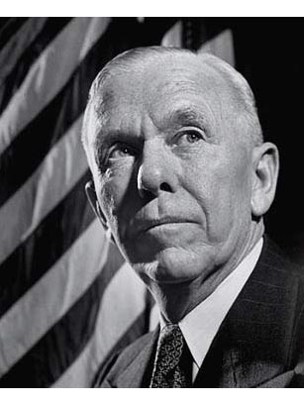
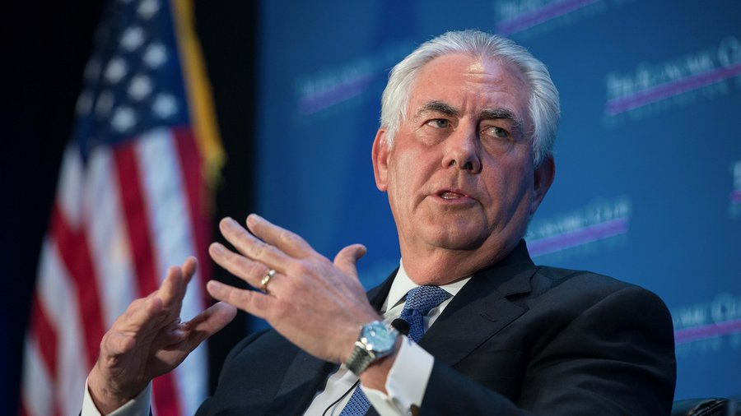
Syrian Economy and the hope
Longer-lasting conflict will have a more negative impact on the economy and institutions, and prolong the recovery:
Lebanon: 16 years of conflict, 20 years to catch up to the real GDP level it enjoyed before the war
Kuwait: two years of conflict, seven years to regain its pre-war GDP level.
Syria: Assuming post conflict starts 2018 @ 4.5% Growth it takes 20 years.
Can the Syrian economy grow magically @ +9 %? then it takes 10 years or less.
With the help of Syrian businessmen, and their brothers in the Gulf countries & their friends in the FREE World, & by using similar plan like “The European Recovery Program” Marshal Plan
Let it be: “The Syrian Recovery Program”
“Tillerson Plan”
Syrians can do it Inshallah!

Slide 18
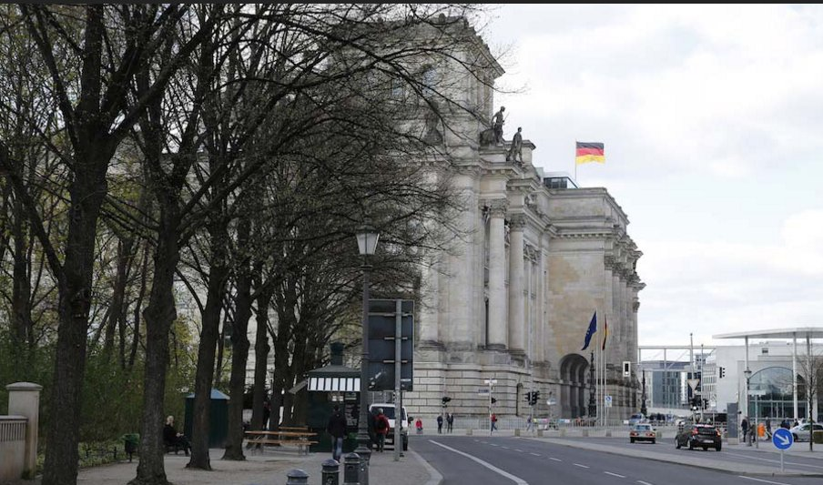
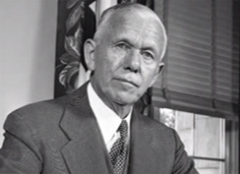
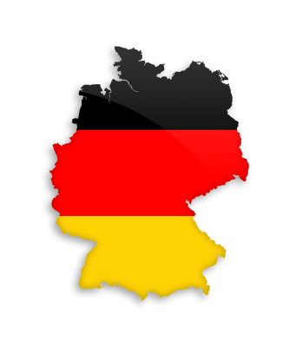
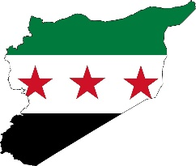
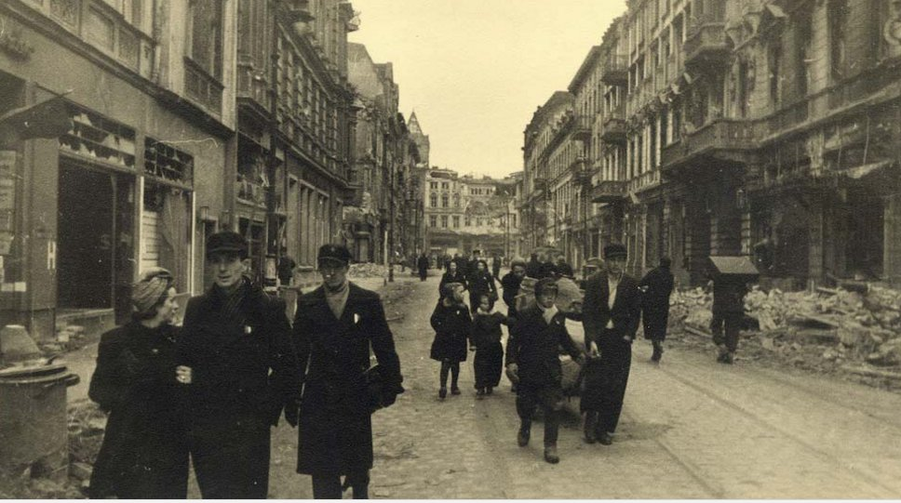
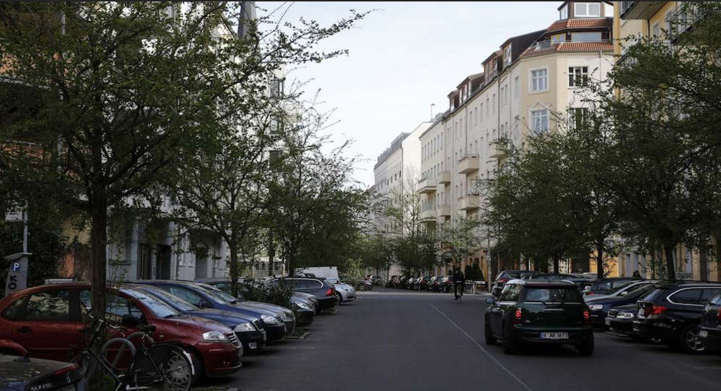
The Marshal Plan
The Tillerson Plan
The European Recovery Program
The Syrian Recovery Program

